Slide 1

WELCOME
Delaware CTR ACCEL – New Project PI Training

Slide 2
Purpose of the DE-CTR ACCEL Program
Delaware CTR ACCEL – New Project PI Training
To build research capacities in States that historically have had low levels of NIH funding by supporting basic, clinical, and translational research through mentoring, education and faculty development, and infrastructure improvements.
Purpose of the New Project PI Training
To ensure that our clinical and translational awardees understand the regulatory commitments of being a federally funded PI. This is an integral component of building research capacities within Delaware.

Slide 3
Delaware CTR ACCEL – New Project PI Training
Overview of Delaware CTR ACCEL
NIH Cooperative Agreement in 13th Year of the Award
Oversite includes a Steering Committee, Internal Advisory Committee, External Advisory Committee and Executive Committee
Four collaborators:
University of Delaware (Prime)
ChristianaCare Health Services, Inc.
Nemours Children’s Health
Delaware State University

Slide 4
Delaware CTR ACCEL – New Project PI Training
Overview of Delaware CTR ACCEL
6 Cores
Administrative (ADMIN)
Pilot Projects Program (PPP)
Biostatistics, Epidemiology & Research Design (BERD)
Professional Development (PDC)
Community Engagement & Outreach (CEO)
Tracking & Evaluation (TEVAL)

Slide 5
Delaware CTR ACCEL – New Project PI Training
Resources
Strategic Partnerships (ASIPPs)
ACCEL Scholars Program
Administrative support and website maintenance
Communications throughout the network
Implementation Scientist- help with communicating your science to communities and more
ADMIN CORE

Slide 6
Delaware CTR ACCEL – New Project PI Training
Resources
Funding mechanisms
Clinical and Translational Pilot Grants
Regular and Community Engaged (1 or 2 years)
Shovel Ready Pilot Grants- (ShoRe) 6 months
INC awards - interdisciplinary new collaboration team grants up to 2 years
Research Retreats- 1 day new collaboration event around a theme
Overcoming Barriers to Translational Success- OrBiTS- infrastructure grants up to 2 years
You will gain Scientific Reviewer experience by sitting on our annual scientific study section which utilizes the NIH model for review.
PPP
PPP

Slide 7
Delaware CTR ACCEL – New Project PI Training
Resources
JIN: peer research network which holds JIN Touch Base Computer-Accessible Conference Calls every Thursday at 9:00AM for <20 minutes. (opportunity to present your project)
Mentoring and Advisory Council (MAC) sessions- MAC sessions comprise a team who review grant proposals
Skills Development Mini-Retreats - 3-4 hour mini-retreats are run by an expert facilitator.
Specific Aims Peer Reviews- one-hour sessions
Grant Writing courses, Flight School, Youtube Library of project presentations
PDC
*Mentored Research Development Awards
offer time/resources to write a grant

Slide 8
Delaware CTR ACCEL – New Project PI Training
Resources/Services
Statistical Analytical plan for grant submissions
Data analysis to complete a paper, write an abstract or scientific presentation
Study design/methodology
Genomics Analysis/Bioinformatics
Data capture/REDCap
Assistance to access the National COVID Cohort Collaborative (N3C) Data enclave and other data sets
BERD

Slide 9
Delaware CTR ACCEL – New Project PI Training
Resources
Provide free consultation to investigators:
-Identifying communities impacted by the research, and how to include them
-Developing outcomes that matter to end users
-Community advisory councils
-Conceptualizing social determinants of health
-Lay abstracts (plain language summaries)
-Dissemination strategies
On-line Community Engaged Research curriculum (ACE)
Annual Community Research Exchange conference
Practice Based Research Network grants working with Primary Care physicians and health centers in Delaware to answer pressing health questions affecting all Delawareans.
CEO
We encourage all investigators to reach out to CEO for assistance with engaging the community in their research (i.e. recruitment).

Slide 10
Delaware CTR ACCEL – New Project PI Training
Resources
Survey Design
Needs Assessments
Retrospective Case Studies
Impact studies (investigator level and institutional level)
TEVAL
Assesses the impact of the
ACCEL Program

Slide 11
Pilot PI Responsibilities
Responsible for all terms and conditions in NIH NOA and Subaward agreement and all NIH policies https://grants.nih.gov/grants/policy/nihgps/HTML5/introduction.htm. Contact your institutional financial administrator with questions.
ACTION: Read the Notice of Award that comes with your project.
ACTION: Read and sign your Award Letter and upload it your project files in the dashboard. (Each of you will receive this presentation through email.)
Responsible for complying with Human Subjects and Clinical Trials requirements.

Slide 12
Pilot PI Responsibilities
Awardees must plan to attend annual ACCEL meetings and should submit work for presentation at national or regional NIH IDeA Conferences.
NISBRE – National conference during even years- coming up June 2026, Washington, D.C. NISBRE2026
Local ACCEL events:
ACCEL holds an Annual Advisory meeting and Symposium late February on the UD campus. You may be asked to present some aspect of your project.
A Community Research Exchange Conference is held every October.
PBRN annual meetings are every Spring.
Professional Development Core JIN meeting presentations on Thursdays
NIH New Investigators
Active participation in the mentoring process is required for both mentors and mentees
Encourage investigators to attend the end of year JIN CARE event (January 15, 2026)
Junior investigators should attend Thursday Network Touchbase Sessions.

Slide 13
Pilot PI Responsibilities
Senior investigators will help with mock study panels for the junior investigator network.
All investigators should be prepared to present their project at a JIN event and to communities they are working with (CEO, PDC and Implementation Scientist)
Responsible for acknowledging federal and state support in publications
You are required to cite the ACCEL grant (NIH U54 GM104941) as a means of support on all publications, posters, articles and if applicable, in Clinical Trials.gov.
Approved Citation: “Work supported in-full/in-part by an Institutional Development Award (IDeA) from the National Institute of General Medical Sciences of the National Institutes of Health under grant number U54-GM104941 (PI: Hicks) and the State of Delaware”
All funded investigators are required to comply with the NIH Public Access Policy which can be found at: https://publicaccess.nih.gov/ (more details on slides 39-46)

Slide 14
Pilot PI Responsibilities
Reviewer responsibilities
As a current awardee, you may be asked to act as a future DE CTR proposal submission reviewer.

Slide 15
Clinical Trials NIH Requirements

Slide 16
Pilot PI Responsibilities: Is it a Clinical Trial?
What is considered a clinical trial?
Use the following four questions to determine the difference between a clinical study and a clinical trial:
Does the study involve human participants?
Are the participants prospectively assigned to an intervention?
Is the study designed to evaluate the effect of the intervention on the participants?
Is the effect being evaluated a health-related biomedical or behavioral outcome?
If answers to these questions are Yes, the study meets the NIH definition of a clinical trial, even if…
You are studying healthy participants
Your study does not have a comparison group (e.g., placebo or control)
Your study is only designed to assess the pharmacokinetics, safety, and/or maximum tolerated dose of an investigational drug
Your study is utilizing a behavioral intervention
Only one aim or sub-aim of your study meets the clinical trial definition
Pilot PI Responsibilities
Responsible for all terms and conditions in NIH NOA and Subaward agreement and all NIH policies https://grants.nih.gov/grants/policy/nihgps/HTML5/introduction.htm. Contact your site administrative contact with questions.
Clinical Trials must be registered on clinicaltrials.gov per NIH policy http://grants.nih.gov/ClinicalTrials_fdaaa/
CTR must notify NIH of all major changes in the status of ongoing protocols
Changes in status of IRB approval(s);
Changes in FDA approval(s) such as Investigational New Drug (IND) Application;
Changes in date of enrollment of first patient into clinical trial and/or date of achievement of target enrollment (last patient);
Unexpected adverse events related to the study which involve increased risk to participants must be communicated to the NIGMS program director within 24 hours of the discovery of the occurrence.

Slide 17
Requirements for Registering & Reporting NIH-funded
Clinical Trials in ClinicalTrials.gov
It is the responsibility of the investigator to ensure that all required information is posted, documentation is uploaded, and specific dates and deadlines are met as required by the NIH. Make certain to include the ACCEL grant (NIH U54 GM104941) when registering your trial on ClinicalTrials.gov.
ACTION (if applicable): Review NIH guidelines for clinical trials.
ACTION (if applicable): Register your clinical trial on ClinicalTrials.gov. Include ACCEL NIH grant U54 GM104941 on the registration as “Other Study ID Numbers.”

Slide 18
Requirements for Registering & Reporting NIH-funded
Clinical Trials in ClinicalTrials.gov
Determine if your project supports a clinical trial
See guidance in Step 1 on this page: https://grants.nih.gov/policy/clinical-trials/reporting/steps.htm
Review full NIH Clinical Trial guidelines:
https://grants.nih.gov/policy/clinical-trials/reporting/index.htm
Review all steps posted here and follow guidance accordingly: https://grants.nih.gov/policy/clinical-trials/reporting/steps.htm

Slide 19
Requirements for Registering & Reporting NIH-funded
Clinical Trials in ClinicalTrials.gov
The following highlight certain requirements that are imperative to remaining in compliance with NIH …
Registration:
Register the study on ClinicalTrials.gov Protocol Registration and Results System (PRS) no later than 21 days after enrolling first participant.
See https://clinicaltrials.gov/submit-studies/prs-help/how-register-study for guidance.
Include the ACCEL grant (NIH U54 GM104941) when registering your trial (e.g. under the Other Study ID Numbers section of registration form).
Informed Consent:
The consent form must be posted on ClinicalTrials.gov after recruitment closes, and no later than 60 days after the last study visit.
Upload an IRB-approved version of the form to the ClinicalTrials.gov study record.
While you can follow the 60-day guidance, we suggest you upload as soon as possible, perhaps after the first participant has enrolled and signed the consent.

Slide 20
Requirements for Registering & Reporting NIH-funded
Clinical Trials in ClinicalTrials.gov
The following highlight certain requirements that are imperative to remaining in compliance with NIH (Continued)…
Clinical trial record updates:
Update clinical trial record at a minimum every 12 months.
Any changes that occur to the clinical trial (e.g. changes to contact information, recruitment, protocol, etc.) must be updated in the PRS within 30 days of the change.
Reporting results:
Summary results must be reported on ClinicalTrials.gov not later than one year after clinical trial primary completion date.
The Primary Completion Date is the date that the last data point for the primary outcome measure was collected from the last enrolled participant.
NOTE: Updates and changes to the clinical trial record require review and approval by ClinicalTrials.gov before appearing public. This process will take at least 30 days.

Slide 21
Pilot PI Responsibilities
Clinical Trials rules and reporting timelines must be satisfied (i.e. registered on clinicaltrials.gov per NIH policy and results reported https://grants.nih.gov/policy-and-compliance/policy-topics/clinical-trials/reporting/understanding)
CTR must notify NIH of all major changes in the status of ongoing protocols such as:
Changes in status of IRB approval(s);
Changes in FDA approval(s) such as Investigational New Drug (IND) Application;
Changes in date of enrollment of first patient into clinical trial and/or date of achievement of target enrollment (last patient)

Slide 22
Reporting Adverse Events
Pilot PI Responsibilities
All adverse events must be reported to the IRB and the NIH and, if appropriate, to the Data and Safety Monitoring Board (DSMB), or other government agencies.
All unanticipated problems must then be reported to the Office of Human Research Protections (OHRP) by the IRB.
Unanticipated adverse events related to the study which involve increased risk to participants must be communicated to the DE CTR PI and the NIGMS program director within 24 hours of the discovery of the occurrence.
What is an unanticipated adverse event?
Any incident, outcome, or problem that is unexpected in nature, severity, or frequency given the research procedures; is related or possibly related to the research participation; and suggests the research places subjects or others at a greater risk of harm than previously known.

Slide 23
Delaware CTR ACCEL – New Project PI Training
Budget Guidelines and Funding Restrictions
Any changes to the approved budget require approval by the CTR Executive Committee. Work with your institutional Financial Administrator to complete a rebudget form. All expenses must be specific to this project, listed in detail in the Budget Justification and backed up with receipts.
There is no automatic carryover of funds (different from many NIH funding mechanisms). Your project is expected to be completed by the budgeted end date. Extensions must be approved by the CTR Executive Committee and NIH and will only be granted in extenuating circumstances.
Participant Compensation: If your project involves participant compensation, please utilize your institution’s tracking mechanism to record this compensation. Please ask your institutional Financial Administrator if you have questions about participant compensation.

Slide 24
Delaware CTR ACCEL – New Project PI Training
Budget Guidelines and Funding Restrictions
If your project ends early for any reason, final financial and technical reporting is required. Work with your institutional Financial Administrator to ensure the award is closed out appropriately.
CTR Project Principal Investigators (PIs) may not have concurrent IDeA research funding (INBRE, COBRE or CTR).

Slide 25
Delaware CTR ACCEL – New Project PI Training
Technical Reporting Requirements
Your Institutional Site PI has direct oversight of your project and will be discussing your entries and outcomes with you. Please be detailed.
Quarterly Interim Progress Reports due September 30, December 31 and June 30. A reporting portal in the ACCEL Dashboard will track progress, any challenges or delays and products or publications.
Final Reports will be due at the completion of your entire project after completion of any No Cost Extensions. (Updated Human Subjects/Clinical Trials forms that identify your project has completed- if applicable). Make sure to mark the question in the ACCEL dashboard report- is this your final report? as YES.

Slide 26
Delaware CTR ACCEL – New Project PI Training
Technical Reporting Requirements
Your Institutional Site PI has direct oversight of your project and will be discussing your entries and outcomes with you. Please be detailed.
NIH Research Performance Progress Report (RPPR) project reporting is due February 28.
Each project has it’s own RPPR within the overall report. Your responses are cut and pasted directly into eRA Commons – please be thorough.
Human Subjects and Clinical Trial Forms must be provided as part of the RPPR, including updated enrollment status and Cumulative (Actual) Enrollment table. Upload to your project files in the dashboard. https://www.grants.gov/web/grants/forms/r-r-family.html
Reminder: The age for each enrolled participant must be identified and listed in the Participant-Level Data Template. This template must be embedded into your HSCT form. The template can be found here on the NIH website:
https://www.era.nih.gov/sites/default/files/2020-05/ParticipantLevelData-Template.xlsx
For Clinical Trials, the Milestones Table needs completion and must be uploaded to the dashboard.

Slide 27
Delaware CTR ACCEL – New Project PI Training
Technical Reporting Requirements
ACCEL is required to submit data to NIGMS with the annual RPPR
We pull this data from your FULL PROFILE page.
CTR funded investigators are required to keep their FULL PROFILE current in the ACCEL dashboard and are required to attest to this.
Your profile must be linked to ORCID, instructions found at: https://www.de-ctr.org/wp-content/uploads/2020/08/DE-CTR-ORCID-iD-1.pdf (Chrome browser recommended)
RPPRs require all products, presentations and publications (citation details to follow) to be reported along with:
Details on submitted proposals for prior 12 months (whether funded or not)
Details on new and continuing current funding
Details on study sections, including name of panel, location and dates

Slide 28
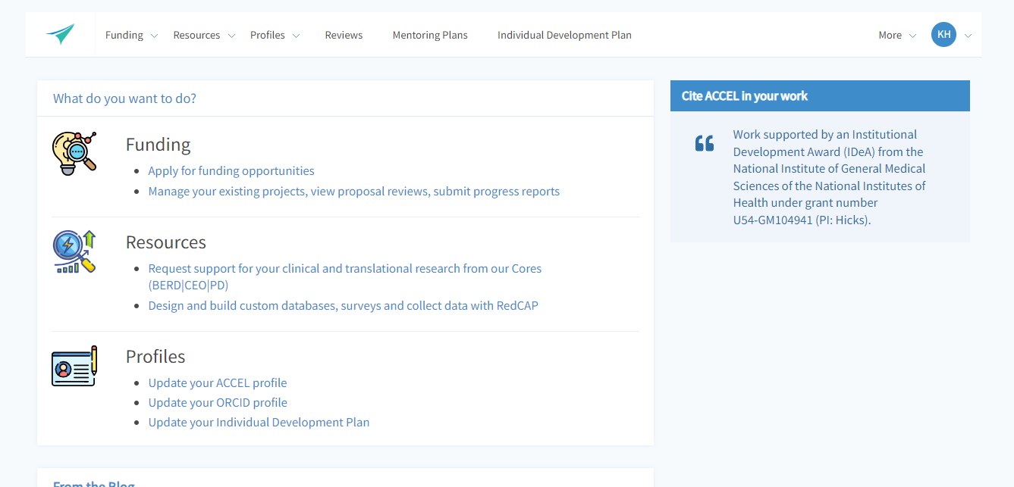
Delaware CTR ACCEL – New Project PI Training
Here’s an example of where to access your profiles on the website dashboard
and how to update of your FULL PROFILE

Slide 29
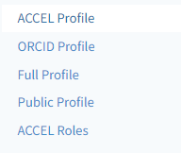
Delaware CTR ACCEL – New Project PI Training
You will have access to any profile, but especially your FULL PROFILE on the
left hand side of the page from the Profiles Menu

Slide 30
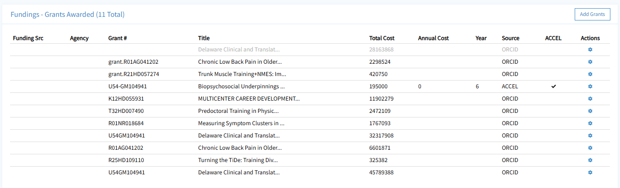
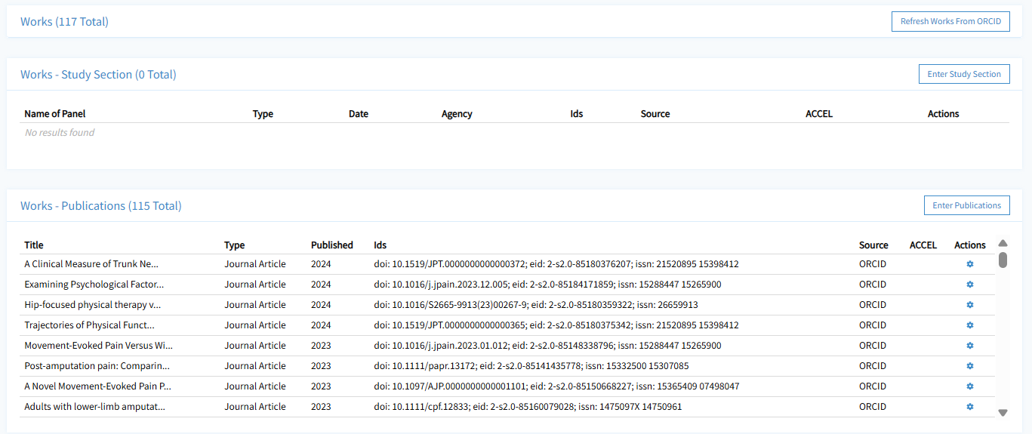
Example of some Full Profile sections on dashboard
Step 1 Import new data from ORCID or manually ADD foundational fundings
Step 3 Confirm the profile is up to date at top of the page- please do so at least every February.
Step 2 Import (refresh) new data from ORCID

Slide 31
We will remind you…………..
You will receive notifications through the website from
connect@de-ctr.org
with a request to complete either a
quarterly progress report or
an RPPR report.
The notification will contain details about accessing the report and due dates.
NOTE: You can always access files and necessary reporting for your project by logging into the ACCEL website, going to project management, selecting the desired project and clicking on the ACTIONS menu on the far right.
YES

Slide 32
When to request an NCE?
Assess your progress between December and February.
Meet with your Institutional Financial Administrator to know your balances on your project.
Meet with your Institutional Site PI to discuss options as extension requests are not automatic or guaranteed.
Formally request an NCE through your project management dashboard in the website.
1. Identify by mid-February if you’ll need an NCE - If approved, we can then project what we’ll need to insert as a placeholder amount for your project for the next award year. (Each award year ends June 30.)
2. If an NCE is needed, go into your project on the dashboard and formally request the extension.
On your dashboard, under Funding> Project Management >Manage your existing projects, view proposal reviews, submit progress reports
Click on your award title in the table> Select ACTIONs button on the right hand and >EXTENSIONS
You will have to provide a reason for the request and the aims you wish to accomplish during the extension, a suggested new end date and the projected balance of your project at the end of your original end date (June 30)
YES

Slide 33
What to know about reporting
Everyone reports quarterly and once a year for the NIH Research Progress Performance Report (RPPR)
Regular CT pilot- 12 months in length
Community Engaged CT pilot- 24 months in length
ACCEL Administrative Supplement projects- usually 12 months in length
INC Awards- 24 months in length
ShoRe Grants- 6 months in length
OrBiTS- up to 24 months in length
September, December
Due March 31
*If Human Subjects- need updated HSF
YES

Slide 34
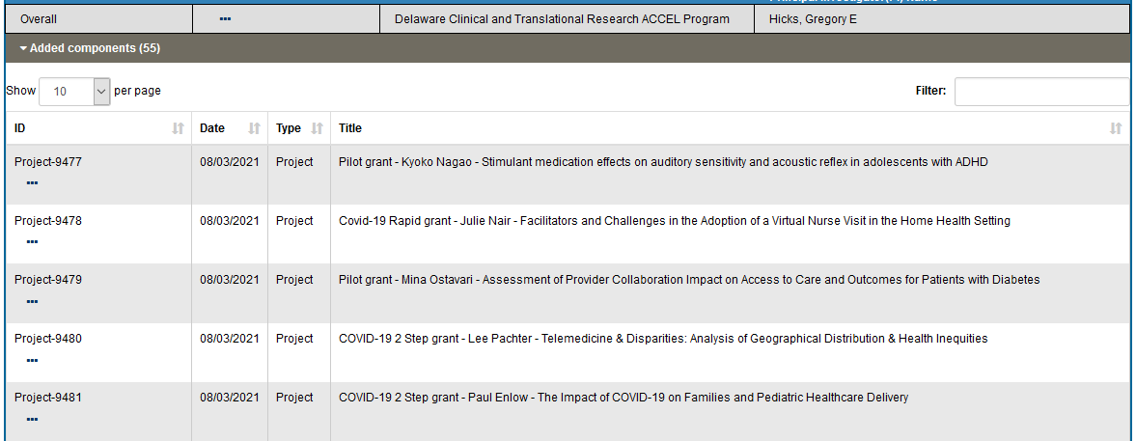
Example of actual NIH RPPR- screenshot
Each project has its own RPPR component report submitted to NIH.
Each Pilot RPPR report contains each section A-H.

Slide 35
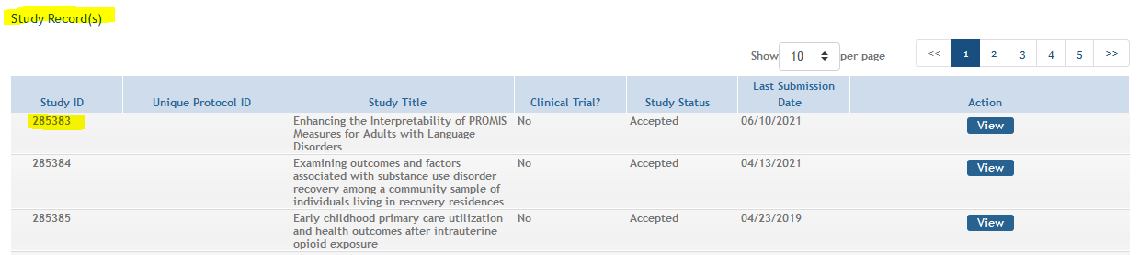
Example of Project Study Record in NIH ASSIST
Each project with human subjects has its own Study Record in the NIH Human Subjects system (ASSIST)
Example of investigator funding reporting required in SIRS
Please note
Study Titles must match in Clinical Trials, ASSIST and within ACCEL records (and IRB). If not, you will need a congruency statement.

Slide 36
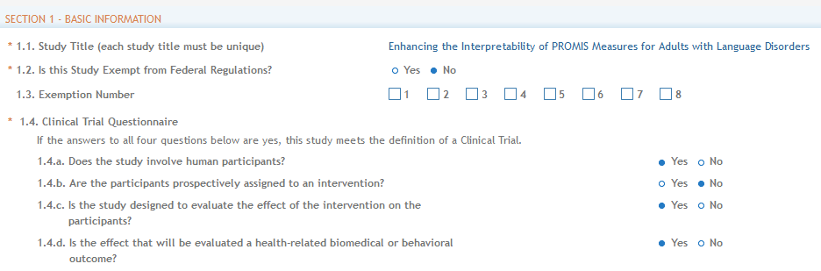
Example of Human Subjects Form pdf
Each Study Record mirrors the Human Subjects Study Record PDF and is entered manually.
In fact- all selections must match to avoid report errors.
If there is a mismatch, we may need to conference to see where it is occurring.

Slide 37
Delaware CTR ACCEL Contacts
Dr. Gregory Hicks, Overall PI, Director and Admin Core Lead (GHicks@udel.edu)
Dr. Susanne Morton, Program Coordinator and UD CTR Site PI (Smmorton@udel.edu)
Dr. Megan Wenner, CTR Pilot Projects Program Lead (MWenner@udel.edu)
Robyne Nizer, CTR Grants Analyst, UD RO (RNizer@udel.edu)
Karen Hough, CTR Program Administrator (Khough@udel.edu)
Jeanne Warrington, CTR Liaison (jeannekw@udel.edu)
ChristianaCare CTR Site PI: Brud Bacon (ABacon@ChristianaCare.org)
Christine Cowan, ChristianaCare CTR Financial Administrator (CCowan@Christianacare.org)
Debra Reese, ChristianaCare CTR Program Manager (Debra.Reese@Christianacare.org) Dr. Sangeeta Gupta, DSU CTR Site PI (SGupta@desu.edu)
Dr. Rodney Scott, Nemours CTR Site PI (Rodney.Scott@nemours.org)
Ranita Chakrabarti, Nemours CTR Financial Administrator (Ranita.Chakrabarti@nemours.org)

Slide 38
FOR CONSORTIUM/CONTRACTUAL ARRANGEMENTS OR MULTI-PROJECT AWARDS When providing Other Support under a consortium/contractual arrangement or that is part of a multi-project award: Indicate the project number, Name of PD/PI, and source of Support for the overall project. Provide all other information (e.g. total award amount) for the subproject only. NIH/NIGMS U54GM104941 (Hicks), Subproject Role: PI Title of subproject Total award amount of subproject
How to list your ACCEL subproject in your OTHSUPPORT

Slide 39
Publications directly resulting from ACCEL projects
Please acknowledge all publications, presentations and posters with the following:
Work supported in-full/in-part by an Institutional Development Award (IDeA) from the National Institute of General Medical Sciences of the National Institutes of Health under grant number U54‑GM104941 (PI: Hicks) and the State of Delaware

Slide 40
NIH Public Access Policy
The ACCEL Program is required to comply with the NIH Public Access Policy which can be found at:
Public Access | Grants & Funding
The 2024 NIH Public Access Policy requires Author Accepted Manuscripts accepted for publication in a journal, on or after July 1, 2025, to be submitted to PubMed Central upon acceptance for publication, for public availability without embargo upon the Official Date of Publication*.
Official Publication date is defined as the earliest when the final manuscript is published either ON-LINE (epub) or in a JOURNAL.

Slide 41
Publishing- UD resources everyone can use
UD resource OA Grant Requirements - Open Access Publishing - Research Guides at University of Delaware
Important considerations:
-The NIH highly encourages authors to tell the journal or publisher during the submission process that if the article is accepted, the Author Accepted Manuscript is subject to the NIH Public Access Policy, and that this means that NIH, as the funding agency, has the right to make the Author Accepted Manuscript publicly available in PubMed Central immediately upon publication. See https://grants.nih.gov/grants/guide/notice-files/NOT-OD-25-049.html
-Compliance with the public access policy means uploading a copy of your published article, or the author accepted manuscript to PubMedCentral. Submitting your article to another institutional repository, UDSpace, or other digital archive cannot be substituted (but can certainly be done in addition to PubMedCentral).
-For a more in-depth discussion about the conflict between journal policies and the NIH public access mandate the Authors Alliance published answers to questions they have received from authors: NIH Public Access Policy: Q&A for Authors

Slide 42
There is a difference between PMID and PMCID
Quick overview:
1-PUBMED is an index. (https://pubmed.ncbi.nlm.nih.gov/) The PubMed database contains more than 32 million citations and abstracts of biomedical literature. Articles are searchable by an assigned PubMed ID # (PMID)
Example 1:
Greenspan B, Cunha AB, Lobo MA. Design and validation of a smart garment to measure positioning practices of parents with young infants. Infant Behav Dev. 2021 Feb;62:101530. doi: 10.1016/j.infbeh.2021.101530. Epub 2021 Feb 4. PMID: 33548894; PMCID: PMC7927978.
2-PubMed Central is a full text archive that includes articles from journals reviewed and selected by National Library of Medicine for archiving (current and historical), as well as individual articles collected for archiving in compliance with funder policies. When papers are submitted to the NIH Manuscript System, they are reviewed, formatted, assigned a PMCID # and deposited to PubMed Central. Having a PMCID # means the manuscript is publicly available in the PubMed Central repository. The above journal article is fully compliant for NIH purposes.

Slide 43
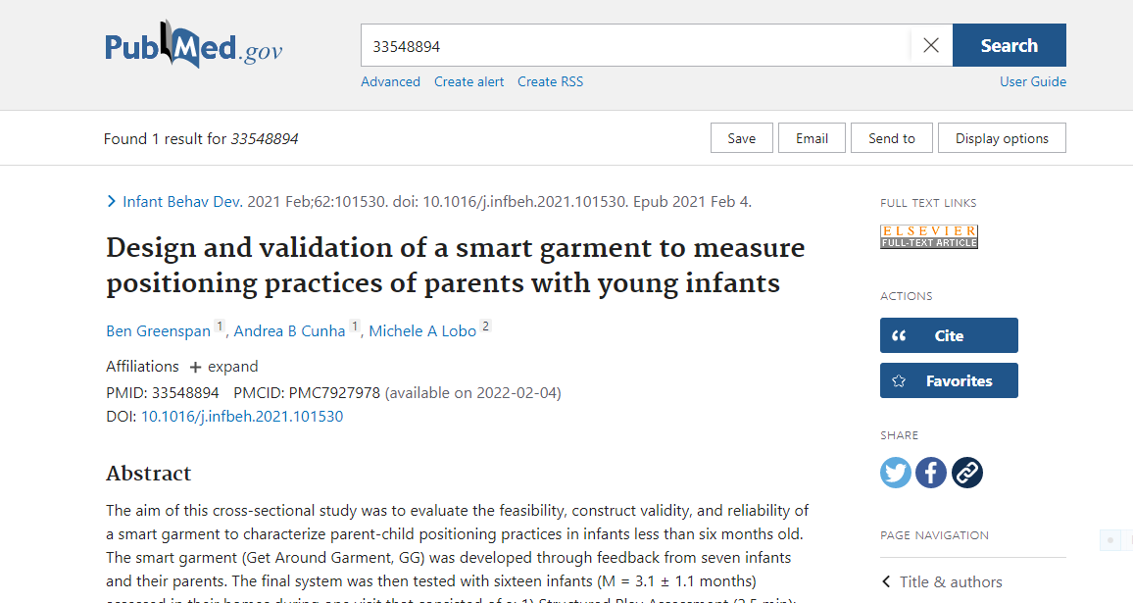
In the past, there were embargo periods
NO LONGER ALLOWABLE FOR ACCEL MANUSCRIPTS accepted for publication on or after July 1, 2025
Notes:
View in pubmed

Slide 44
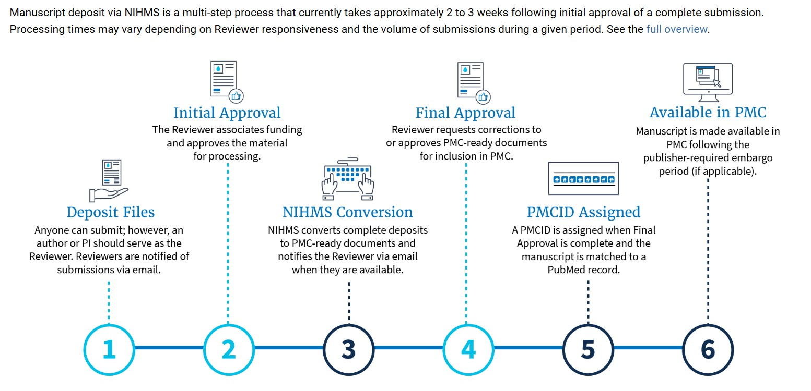
NIH Manuscript System resources
NIHMS login: Sign in – NIHMS Frequently Asked Questions - NIHMS

Slide 45
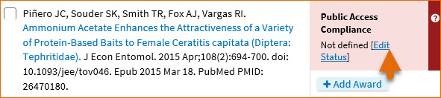
Please take this additional step
We check on a monthly basis if publications are out of compliance and contact the ACCEL affiliated author. It could affect DE-CTR ACCEL Program subsequent award year funding if acquisition of a PMCID is not completed in a timely manner.
The final step for making sure ACCEL is acknowledged in your project’s publications:
*You must also add the ACCEL award (U54‑GM104941) to your manuscript in your MY NCBI account
https://www.ncbi.nlm.nih.gov/books/NBK53595/#mybibliography.Viewing_New_Citations_Lin
Not defined citations do not have awards associated to them and they do not display a PMCID. Citations that are not defined need to be identified as publications supported by NIH grants; click “Edit Status” to confirm that an article was partly or wholly supported by NIH grants. NIH funding information can be added to not defined citations by clicking the “Add award” button.

Slide 46
Final suggestions and best practices
FOR BEST PRACTICES:
1)Timing- Do not wait. Being assigned a PMCID can be a rather long process ~ 4 weeks.
2) What papers require a PMCID?
The Policy applies to any manuscript that:
-Is peer-reviewed;
-And, is accepted for publication in a journal² on or after April 7, 2008³;
-And, arises from:
Any direct funding⁴ from an NIH grant or cooperative agreement active in Fiscal Year 2008 or beyond, or;
Any direct funding from an NIH contract signed on or after April 7, 2008, or;
Any direct funding from the NIH Intramural Program, or;
An NIH employee
Remember- acknowledging ACCEL support is a 2 step process:
1) As an NIH ACCEL funded author, make sure a PMCID # is obtained for your publication AND
2) EDIT your bibliography in My NCBI and add the ACCEL grant award to that publication. Choose your paper within your Bibliography, click on the + button under add award and search for GM104941. This is then added to Dr. Hick’s bibliography as Program Principal Investigator and counted towards the ACCEL Program’s publications overall.

Slide 47
Please work with the aCCEL Implementation Scientist Katrina Morrison Katrinam@udel.edu
Help with communicating your work to communities and beyond……

Slide 48
We want to share your accomplishments, publications, awards, and funding announcements!
Share your work!
When you …
But WHY should I share? WIN-WIN!
Publish your work
Conduct a presentation about your research
Interview with a media outlet about your research/findings
Receive an award for your work
Receive another grant/funding to further your research
Have anything awesome to share with ACCEL and the community
Your name, research and accomplishments are shared with fellow researchers, the community and spread across social media channels/internet
ACCEL gets more/better content on our website and social media channels that demonstrates the impact of ACCEL’s work, and the program’s success
Communications : Conner Holm
conner.holm@nemours.org

Slide 49

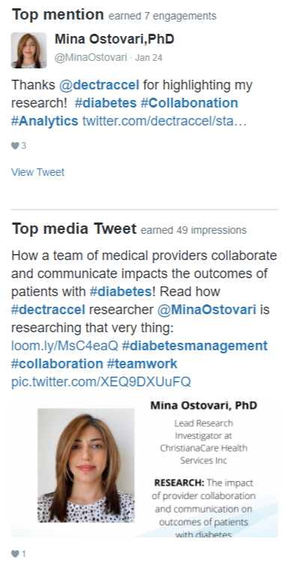
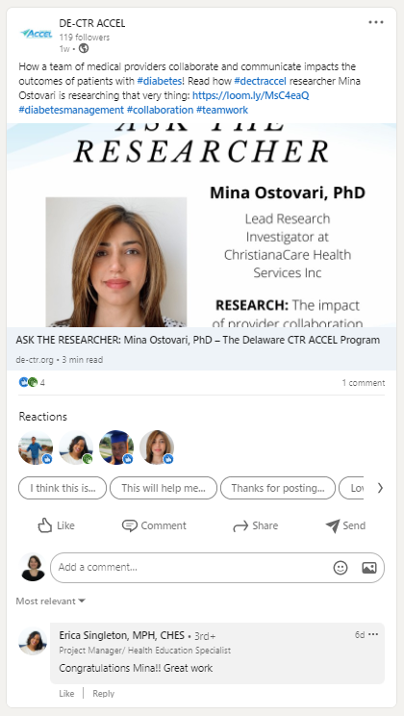
Importance of Dissemination/Social Sharing
Why it’s important: Showcase your work and accomplishment(s) on the ACCEL website, in the newsletter, and on social media to share with the world! It will be seen:
Newsletter Example
Twitter Example
LinkedIn Example
ACCEL website is for fellow researchers and the community
Enable networking with fellow researchers
Community can interface and understand the impact of ACCEL’s work
Full integration between the newsletter and ACCEL website
Avg. 431 opens/newsletter issue
Avg. 110 clicks/newsletter issue
Presence and posting across 4 main social media channels (including user/organization tagging and appropriate hashtags)
Twitter (avg. 432 impressions/tweet)
LinkedIn (Avg. 199.8 impressions; 117.6 unique impressions/twee)
Facebook & Instagram (avg. page/profile reach: 16)

Slide 50

Feel free to use this electronic logo if needed for posters
Thank you for your help in making the
ACCEL Program a success !!

