Slide 1
WELCOME
Delaware CTR ACCEL – New Project PI Training

Slide 2
Purpose of the DE-CTR ACCEL Program
Delaware CTR ACCEL – New Project PI Training
To build research capacities in States that historically have had low levels of NIH funding by supporting basic, clinical, and translational research through mentoring, education and faculty development, and infrastructure improvements.
Purpose of the New Project PI Training
To ensure that our clinical and translational awardees understand the regulatory commitments of being a federally funded PI. This is an integral component of building research capacities within Delaware.

Slide 3
Delaware CTR ACCEL – New Project PI Training
Overview of Delaware CTR ACCEL
NIH Cooperative Agreement in 11th Year of the Award
Oversite includes Steering Committee with NIH participation, Internal Advisory Committee, External Advisory Committee and Executive Committee
Four collaborators:
University of Delaware (Prime)
ChristianaCare Health Services, Inc.
Nemours Children’s Health
Delaware State University

Slide 4
Delaware CTR ACCEL – New Project PI Training
Overview of Delaware CTR ACCEL
6 Cores
Administrative (ADMIN)
Pilot Projects Program (PPP)
Biostatistics, Epidemiology & Research Design (BERD)
Professional Development (PDC)
Community Engagement & Outreach (CEO)
Tracking & Evaluation (TEVAL)

Slide 5
Delaware CTR ACCEL – New Project PI Training
Resources
Strategic Partnerships (ASIPPs)
ACCEL Scholars Program
Administrative support and website maintenance
Communications throughout the network
Health Equity initiatives throughout the program
ADMIN CORE

Slide 6
Delaware CTR ACCEL – New Project PI Training
Resources
Multiple Funding mechanisms
Clinical and Translational Pilot Grants
Regular and Community Engaged (1 or 2 years)
Shovel Ready Pilot Grants- (ShoRe) 6 months
INC awards (soon)- interdisciplinary new collaboration team grants up to 2 years
Research Retreats- 1 day new collaborative event around a theme
Overcoming Barriers to Translational Success- OrBiTS- infrastructure grants up to 2 years
You can gain Scientific Reviewer experience by sitting on our annual scientific study section which utilizes the NIH model for review.
PPP
PPP

Slide 7
Delaware CTR ACCEL – New Project PI Training
Resources
JIN: peer research network which holds JIN Touch Base Computer-Accessible Conference Calls every Thursday at 9:00AM for <20 minutes. (opportunity to present your project)
Mentoring and Advisory Council (MAC) sessions- MAC sessions comprise a team who review grant proposals
Skills Development Mini-Retreats - 3-4 hour mini-retreats are run by an expert facilitator.
Specific Aims Peer Reviews- one-hour sessions
Grant Writing courses, Flight School, Youtube Library of project presentations
PDC
*Mentored Research Development Awards

Slide 8
Delaware CTR ACCEL – New Project PI Training
Resources/Services
Statistical Analytical plan for grant submission
Data analysis to complete a paper, write an abstract or scientific presentation
Study design/methodology
Genomics Analysis/Bioinformatics
Data capture/REDCap
Assistance to access the National COVID Cohort Collaborative (N3C) Data enclave
BERD

Slide 9
Delaware CTR ACCEL – New Project PI Training
Resources
Provide free consultation to investigators:
-Identifying communities impacted by the research, and how to include them
-Developing outcomes that matter to end users
-Community advisory councils
-Conceptualizing social determinants of health
-Lay abstracts (plain language summaries)
-Dissemination strategies
On-line Community Engaged Research curriculum (ACE)
Annual Community Research Exchange conference
Coming Soon: Practice Based Research Network grants working with Primary Care physicians and health centers in Delaware to answer pressing health questions affecting all Delawareans.
CEO
We encourage all investigators to reach out to CEO for assistance with engaging the community in their research (i.e. recruitment).

Slide 10
Delaware CTR ACCEL – New Project PI Training
Resources
Survey Design
Needs Assessments
Retrospective Case Studies
TEVAL
Assesses the impact of the
ACCEL Program

Slide 11
Pilot PI Responsibilities
Responsible for all terms and conditions in NIH NOA and Subaward agreement and all NIH policies https://grants.nih.gov/grants/policy/nihgps/HTML5/introduction.htm. Contact your institutional financial administrator with questions.
ACTION: Read the Notice of Award that comes with your project.
ACTION: Read and sign your Award Letter and upload it your project files in the dashboard. (Each of you will receive this presentation through email.)
Responsible for complying with Human Subjects and Clinical Trials requirements.

Slide 12
Clinical Trials NIH Requirements

Slide 13
Pilot PI Responsibilities- is it a Clinical Trial?
What is considered a clinical trial?
Use the following four questions to determine the difference between a clinical study and a clinical trial:
Does the study involve human participants?
Are the participants prospectively assigned to an intervention?
Is the study designed to evaluate the effect of the intervention on the participants?
Is the effect being evaluated a health-related biomedical or behavioral outcome?
Note that if the answers to the 4 questions are yes, your study meets the NIH definition of a clinical trial, even if…
You are studying healthy participants
Your study does not have a comparison group (e.g., placebo or control)
Your study is only designed to assess the pharmacokinetics, safety, and/or maximum tolerated dose of an investigational drug
Your study is utilizing a behavioral intervention
Only one aim or sub-aim of your study meets the clinical trial definition
Pilot PI Responsibilities
Responsible for all terms and conditions in NIH NOA and Subaward agreement and all NIH policies https://grants.nih.gov/grants/policy/nihgps/HTML5/introduction.htm. Contact your site administrative contact with questions.
Clinical Trials must be registered on clinicaltrials.gov per NIH policy http://grants.nih.gov/ClinicalTrials_fdaaa/
CTR must notify NIH of all major changes in the status of ongoing protocols
Changes in status of IRB approval(s);
Changes in FDA approval(s) such as Investigational New Drug (IND) Application;
Changes in date of enrollment of first patient into clinical trial and/or date of achievement of target enrollment (last patient);
Unexpected adverse events related to the study which involve increased risk to participants must be communicated to the NIGMS program director within 24 hours of the discovery of the occurrence.

Slide 14
Requirements for Registering & Reporting NIH-funded
Clinical Trials in ClinicalTrials.gov
It is the responsibility of the investigator to ensure that all required information is posted, documentation is uploaded, and specific dates and deadlines are met as required by the NIH. Make certain to include the ACCEL grant (NIH U54 GM104941) when registering your trial on ClinicalTrials.gov.
ACTION (if applicable): Review NIH guidelines for clinical trials.
ACTION (if applicable): Register your clinical trial on ClinicalTrials.gov. Include ACCEL NIH grant U54 GM104941 on the registration as “Other Study ID Numbers.”

Slide 15
Requirements for Registering & Reporting NIH-funded
Clinical Trials in ClinicalTrials.gov
Determine if your project supports a clinical trial
See guidance in Step 1 on this page: https://grants.nih.gov/policy/clinical-trials/reporting/steps.htm
Review full NIH Clinical Trial guidelines:
https://grants.nih.gov/policy/clinical-trials/reporting/index.htm
Review all steps posted here and follow guidance accordingly: https://grants.nih.gov/policy/clinical-trials/reporting/steps.htm

Slide 16
Requirements for Registering & Reporting NIH-funded
Clinical Trials in ClinicalTrials.gov
The following highlight certain requirements that are imperative to remaining in compliance with NIH …
Register a Clinical Trial on ClinicalTrials.gov Protocol Registration and Results System (PRS) no later than 21 days after enrolling first participant.
See https://classic.clinicaltrials.gov/ct2/manage-recs for guidance.
Include the ACCEL grant (NIH U54 GM104941) when registering your trial (e.g. under the Other Study ID Numbers section of registration form).
Post Informed consent documents on a public federal website (e.g. ClinicalTrials.gov) after recruitment closes and no later than 60 days after the last study visit. While you can follow this 60 day guidance, we suggest you upload as soon as possible, perhaps after the first participant has enrolled and signed the consent.
Update information in the clinical trial record at a minimum every 12 months. Any changes that occur to the clinical trial (e.g. changes to contact information, recruitment, protocol, etc.) must be updated in the PRS within 30 days of change.
Report summary results on ClinicalTrials.gov not later than one year after clinical trial primary completion date. The Primary Completion Date is the date that the last data point for the primary outcome measure was collected from the last enrolled participant.
NOTE: Updates and changes to the clinical trial record require review and approval by ClinicalTrials.gov before appearing public. This process will take at least 30 days.

Slide 17
Pilot PI Responsibilities
Responsible for all terms and conditions in NIH NOA and Subaward agreement and all NIH policies https://grants.nih.gov/grants/policy/nihgps/HTML5/introduction.htm. Contact your institutional financial administrator with questions.
As mentioned in the previous slides, Clinical Trials rules and reporting timelines must be satisfied (i.e. registered on clinicaltrials.gov per NIH policy and results reported http://grants.nih.gov/ClinicalTrials_fdaaa/ )
CTR must notify NIH of all major changes in the status of ongoing protocols
Changes in status of IRB approval(s);
Changes in FDA approval(s) such as Investigational New Drug (IND) Application;
Changes in date of enrollment of first patient into clinical trial and/or date of achievement of target enrollment (last patient);
Unexpected adverse events related to the study which involve increased risk to participants must be communicated to the NIGMS program director within 24 hours of the discovery of the occurrence.

Slide 18
Pilot PI Responsibilities
Awardees must plan to attend annual ACCEL meetings and should submit work for presentation at national or regional NIH IDeA Conferences.
NISBRE – National conference during even years- coming up June 2024, Washington, D.C.
NERIC – Regional conference during odd years- August 2025
Local ACCEL events:
ACCEL will be holding an Annual Advisory meeting and Renewal Celebration on February 29, 2024 from 1-5pm in the STAR Tower Audion on the UD campus. You may be asked to present your some aspect of your project.
A Community Research Exchange Conference is being planned for October 2024.

Slide 19
Delaware CTR ACCEL – New Project PI Training
The 9th Biennial National IDeA Symposium of Biomedical Research Excellence (NISBRE) will be held in Washington, D.C. June 16-20, 2024 at the Washington Hilton. Louisiana State University (LSU) has been awarded an NIH: NIGMS U13 grant to organize the 2024 and 2026 NISBRE meetings.
The NISBRE is a national scientific meeting to showcase the scientific and training accomplishments of the IDeA program of the National Institute of General Medical Sciences (NIGMS). The IDeA program develops scientific centers of excellence and also supports Networks such as INBRE, COBRE, and IDeA-CTR programs and trains biomedical scientists in the IDeA-eligible states.
www.naipi.org
Website and Registration Link
Coming Soon!

Slide 20
Pilot PI Responsibilities
NIH New Investigators
Active participation in the mentoring process is required for both mentors and mentees
Encourage investigators to attend the end of year JIN CARE event
Junior investigators will send a representative to or attend Thursday Network Touchbase Sessions.
Senior investigators will help with mock study panels for the junior investigator network.
All investigators should be prepared to present their project at a JIN event and to communities they are working with.
You are required to cite the ACCEL grant (NIH U54 GM104941) as a means of support on all publications, posters, articles and if applicable, in Clinical Trials.gov.
Approved Citation: “Work supported by an Institutional Development Award (IDeA) from the National Institute of General Medical Sciences of the National Institutes of Health under grant number U54-GM104941 (PI: Hicks) and the State of Delaware”

Slide 21
Pilot PI Responsibilities
For publications: Our program and all funded investigators are required to comply with the NIH Public Access Policy which can be found at: https://publicaccess.nih.gov/ (more details in last slide section)

Slide 22
Delaware CTR ACCEL – New Project PI Training
Budget Guidelines and Funding Restrictions
Any changes to the approved budget require approval by the CTR Executive Committee. Work with your institutional Financial Administrator to complete a rebudget form. All expenses must be specific to this project and must be backed up with receipts. As an example- computer software/hardware requests should be for this specific CTR project only and should be detailed in the Budget Justification as such.
There is no automatic carryover of funds (different from many NIH funding mechanisms). Your project is expected to be completed by the budgeted end date. Extensions must be approved by the CTR Executive Committee and NIH and will only be granted in extenuating circumstances.
Participant Compensation: If your project involves participant compensation, please utilize your institution’s tracking mechanism to record this compensation. Please ask your institutional Financial Administrator if you have questions about participant compensation.

Slide 23
Delaware CTR ACCEL – New Project PI Training
Budget Guidelines and Funding Restrictions
If your project ends early for any reason, final financial and technical reporting is required. Work with your institutional Financial Administrator to ensure the award is closed out appropriately.
CTR investigators may not have concurrent IDeA research funding (INBRE, COBRE or CTR).

Slide 24
Delaware CTR ACCEL – New Project PI Training
Technical Reporting Requirements
Your Institutional Site PI has direct oversight of your project and will be discussing your entries and outcomes with you. Please be detailed.
Quarterly Interim Progress Reports due September 30, December 31 and June 30. A reporting portal in the ACCEL Dashboard will track progress, any challenges or delays and products or publications.
Final Reports will be due at the completion of your entire project after completion of any No Cost Extensions. (Updated Human Subjects/Clinical Trials forms that identify your project has completed- if applicable). Make sure to mark the question in the ACCEL dashboard report- is this your final report? as YES.

Slide 25
Delaware CTR ACCEL – New Project PI Training
Technical Reporting Requirements
Your Institutional Site PI has direct oversight of your project and will be discussing your entries and outcomes with you. Please be detailed.
NIH Research Performance Progress Report (RPPR) project reporting is due around February 28.
Each project has it’s own RPPR within the overall report. Your responses are cut and pasted directly into eRA Commons – please be thorough.
Human Subjects and Clinical Trial Forms must be provided as part of the RPPR, including updated enrollment status and Cumulative (Actual) Enrollment table. Upload to your project files in the dashboard. https://www.grants.gov/web/grants/forms/r-r-family.html
NEW: The age for each enrolled participant must be identified and listed in the Participant-Level Data Template. This template must be embedded into your HSCT form. The template can be found here on the NIH website:
https://www.era.nih.gov/sites/default/files/2020-05/ParticipantLevelData-Template.xlsx

Slide 26
Delaware CTR ACCEL – New Project PI Training
Technical Reporting Requirements
ACCEL is required to submit data to NIGMS
All CTR funded investigators are required to keep their FULL PROFILE current in the ACCEL dashboard and are required to attest to this.
Your profile must be linked to ORCID, instructions found at: https://www.de-ctr.org/wp-content/uploads/2020/08/DE-CTR-ORCID-iD-1.pdf (Chrome browser recommended)
RPPRs require all products, presentations and publications (citation details to follow) to be reported along with:
Details on submitted proposals for prior 12 months (whether funded or not)
Details on new and continuing current funding
Details on study sections, including name of panel, location and dates

Slide 27
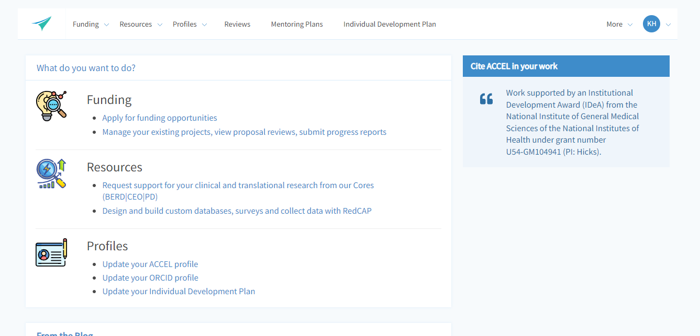
Delaware CTR ACCEL – New Project PI Training
Here’s an example of where to access your profiles on the website dashboard
and how to update of your FULL PROFILE

Slide 28
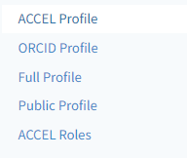
Delaware CTR ACCEL – New Project PI Training
You will have access to any profile, but especially your FULL PROFILE on the
left hand side of the page from the Profiles Menu

Slide 29
We will remind you…………..
You will receive notifications through the website from
connect@de-ctr.org
with a request to complete either a
quarterly progress report or
an RPPR report.
The notification will contain details about accessing the report and due dates.
NOTE: You can always access files and necessary reporting for your project by logging into the ACCEL website, going to project management, selecting the desired project and clicking on the ACTIONS menu on the far right.
YES

Slide 30
When to request an NCE?
Assess your progress between December and February.
Meet with your Institutional Financial Administrator to know your balances on your project.
Meet with your Institutional Site PI to discuss options as extension requests are not automatic or guaranteed.
1. Identify by February if you’ll need an NCE - If approved, we can then project what we’ll need to insert as a placeholder amount for your project for the next award year. (Each award year ends June 30.)
2. If an NCE is needed, go into your project on the dashboard and formally request the extension.
On your dashboard, under Funding> Project Management >Manage your existing projects, view proposal reviews, submit progress reports
Click on your award title in the table> Select ACTIONs button on the right hand and >EXTENSIONS
You will have to provide a reason for the request and the aims you wish to accomplish during the extension, a suggested new end date and the projected balance of your project at the end of the original end date (June 30)
YES

Slide 31
What to know about reporting
Year 11 Pilots will begin January 1, 2024. They will be multi-year projects and have planned NCEs with good progress.
Regular CT pilot- 12 months in length
January 1, 2024- June 30, 2024
July 1, 2024 – December 31, 2024 (Active in yrs. 11-12)
Community Engaged CT pilot- 24 months in length
January 1, 2024- June 30, 2024
July 1, 2024- June 30, 2025
July 1, 2025 - December 31, 2025 (Active in yrs. 11-13)
ACCEL Administrative Supplement projects have already started. These will end June 2024 unless an NCE is granted by NIH.
September, December
Due March 31
*If Human Subjects- need updated HSF
YES

Slide 32
Reporting
MULTIPLE YEAR PROJECT?
FINAL REPORT
A Final Report is due at the end of the entire project
If Human Subjects- need final updated HS/CT form
INTERIM REPORTING
NIH RPPR
Due February 28 for each award year the project is active *
*If your project includes Human Subjects/ CT - you will need to upload updated form to your project files bank
Regular and Community Engaged Pilots
NCE approved
INC awards
June 30
September 30
December 31
YES
First year RPPR for all
Completion by Feb 29, 2024
Second year RPPR for CT and CE
Completion by Feb 28, 2025
Third year RPPR CE projects
Completion Feb 28, 2026
If you’ve identified as a Clinical Trial, you’ll also have to report results within a year of the primary completion date in ClinicalTrials.gov. Again, make sure ACCEL CTR is cited, your informed consent is uploaded and your trial is registered within 21 days of your initial patient recruitment.
Current supplement projects will report for quarterly interims and an RPPR in February 2024.

Slide 33
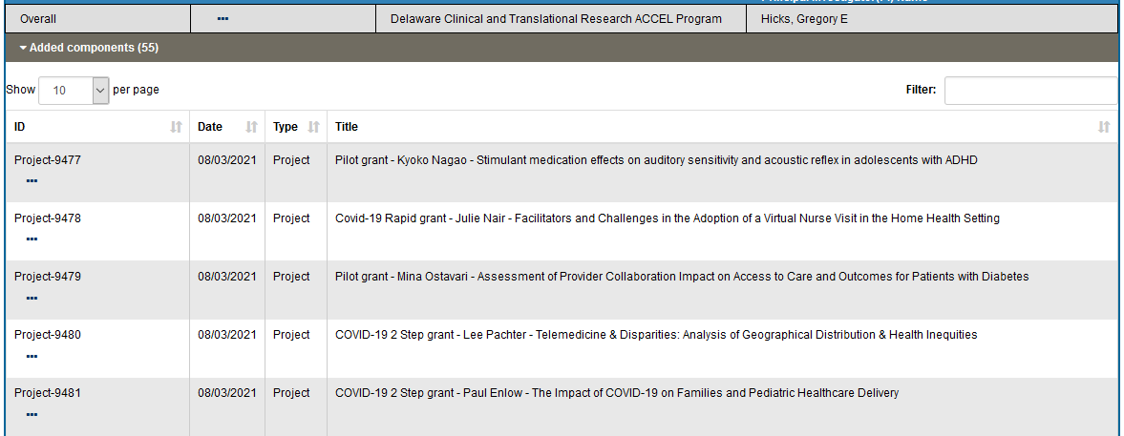
Example of actual NIH RPPR- screenshot
Each project has its own RPPR component report submitted to NIH.
Each Pilot RPPR report contains each section A-H.

Slide 34
Example of Project Study Record in NIH ASSIST
Each project with human subjects has its own Study Record in the NIH Human Subjects system (ASSIST)
Example of investigator funding reporting required in SIRS
Please note
Study Titles must match in Clinical Trials, ASSIST and within ACCEL records (and IRB). If not, you will need a congruency statement.

Slide 35
Example of Human Subjects Form pdf
Each Study Record mirrors the Human Subjects Study Record PDF and is entered manually.
In fact- all selections must match to avoid report errors.
If there is a mismatch, we may need to conference to see where it is occurring.

Slide 36
FOR CONSORTIUM/CONTRACTUAL ARRANGEMENTS OR MULTI-PROJECT AWARDS When providing Other Support under a consortium/contractual arrangement or that is part of a multi-project award: Indicate the project number, Name of PD/PI, and source of Support for the overall project. Provide all other information (e.g. total award amount) for the subproject only. NIH/NIGMS U54GM104941 (Hicks), Subproject Role: PI Title of subproject Total award amount of subproject
How to list your ACCEL subproject in your OTHSUPPORT

Slide 37
Delaware CTR ACCEL Contacts
Dr. Gregory Hicks, Overall PI, Director and Admin Core Lead (ghicks@udel.edu)
Dr. Susanne Morton, Program Coordinator and UD CTR Site PI (smmorton@udel.edu)
Dr. Megan Wenner, CTR Pilot Projects Program Lead (mwenner@udel.edu)
Robyne Nizer, CTR Grants Analyst, UD RO (rnizer@udel.edu)
Karen Hough, CTR Program Administrator (khough@udel.edu)
Jeanne Warrington, CTR Liaison (jeannekw@udel.edu)
ChristianaCare CTR Site PI: currently vacant (email Claudine Jurkovitz Cjurkovitz@christianacare.org)
Christine Cowan, ChristianaCare CTR Financial Administrator (CCowan@Christianacare.org)
Debra Reese, ChristianaCare CTR Program Manager (Debra.Reese@Christianacare.org) Dr. Sangeeta Gupta, DSU CTR Site PI (sgupta@desu.edu)
Dayna Littleton, DSU CTR Administrator (dlittleton@desu.edu)
Dr. Rodney Scott, Nemours CTR Site PI (Rodney.Scott@nemours.org)
Ranita Chakrabarti, Nemours CTR Financial Administrator (Ranita.Chakrabarti@nemours.org)

Slide 38
Publications directly resulting from ACCEL projects
Please acknowledge all publications, presentations and posters with the following:
Work supported by an Institutional Development Award (IDeA) from the National Institute of General Medical Sciences of the National Institutes of Health under grant number U54‑GM104941 (PI: Hicks) and the State of Delaware

Slide 39
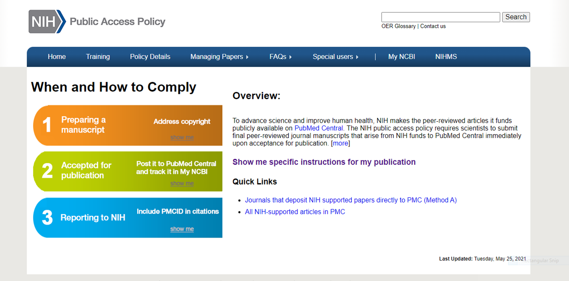
NIH Public Access Policy
The ACCEL Program is required to comply with the NIH Public Access Policy which can be found at:
https://publicaccess.nih.gov/
All NIH funded programs and NIH supported authors are required to make sure that their final peer-reviewed journal manuscripts are publicly available (free) within 12 months of publication.

Slide 40
There is a difference between PMID and PMCID
PMID vs PMCID
Quick overview:
1-PUBMED is an index. (https://pubmed.ncbi.nlm.nih.gov/) The PubMed database contains more than 32 million citations and abstracts of biomedical literature. Articles are searchable by an assigned PubMed ID # (PMID)
Example 1:
Greenspan B, Cunha AB, Lobo MA. Design and validation of a smart garment to measure positioning practices of parents with young infants. Infant Behav Dev. 2021 Feb;62:101530. doi: 10.1016/j.infbeh.2021.101530. Epub 2021 Feb 4. PMID: 33548894; PMCID: PMC7927978.
2-PubMed Central is a full text archive that includes articles from journals reviewed and selected by National Library of Medicine for archiving (current and historical), as well as individual articles collected for archiving in compliance with funder policies. When papers are submitted to the NIH Manuscript System, they are reviewed, formatted, assigned a PMCID # and deposited to PubMed Central. Having a PMCID # means the manuscript will be publicly available in PubMed Central within 12 months of publication without purchase. The above journal article is fully compliant for NIH purposes.

Slide 41
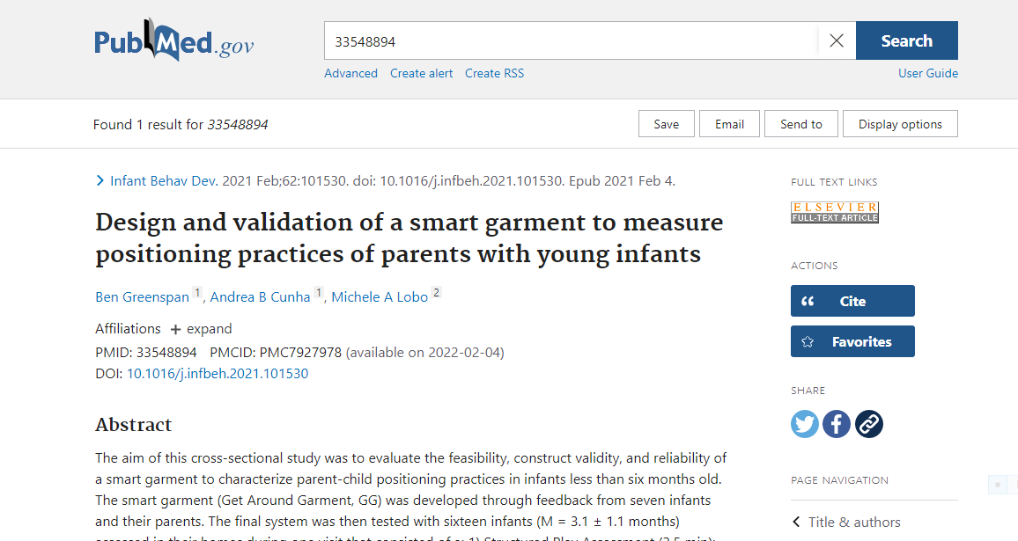
Embargoes
Notes:
View in pubmed

Slide 42
NIH Manuscript System resources
Non-compliance happens for several reasons because the process to be assigned a PMCID is different depending upon the journal your paper is published in. PMCID numbers are obtained by the publishers submitting either the final published article or the author submitting the final peer-reviewed manuscript to the NIH Manuscript System (NIHMS).
Some journals directly submit the final published article within 3 months to NIHMS without author involvement
Some journals/publishers will submit the final published article to NIHMS for the author if you pay a fee- this should be outlined in your contract as the author has to pay for this arrangement.
Some journals do not submit for authors and one of the authors (or designee) must submit the final peer-reviewed article.
While you may not be the first author, you as an ACCEL author should make sure that the final peer-reviewed article is submitted to NIHMS to receive a PMCID #. Before starting the process, you should communicate with the first author to avoid duplicate requests.
Notes:
The situation in red is the issue we see most often.

Slide 43
Please take this additional step-
We check on a quarterly basis if publications are out of compliance and contact the ACCEL affiliated author. It could affect DE-CTR ACCEL Program subsequent award year funding if acquisition of a PMCID is not completed in a timely manner.
The final step for making sure ACCEL is acknowledged in your project’s publications:
*You must also add the ACCEL award (U54‑GM104941) to your publication in your MY NCBI account.

Slide 44
Final suggestions and best practices
FOR BEST PRACTICES:
1)Timing- Do not wait. Being assigned a PMCID can be a rather long process ~ 4-6 weeks. Make sure either the publisher or an author will be responsible for securing a PMCID.
2) What papers require a PMCID?
The Policy applies to any manuscript that:
-Is peer-reviewed;
-And, is accepted for publication in a journal² on or after April 7, 2008³;
-And, arises from:
Any direct funding⁴ from an NIH grant or cooperative agreement active in Fiscal Year 2008 or beyond, or;
Any direct funding from an NIH contract signed on or after April 7, 2008, or;
Any direct funding from the NIH Intramural Program, or;
An NIH employee
Remember- acknowledging ACCEL support is a 2 step process:
1) As an NIH ACCEL funded author, make sure a PMCID # is obtained for your publication AND
2) EDIT your bibliography in My NCBI and add the ACCEL grant award to that publication. Choose your paper within your Bibliography, click on the + button under add award and search for GM104941. This is then added to Dr. Hick’s bibliography as Program Principal Investigator and counted towards the ACCEL Program’s publications overall.

Slide 45
We want to share your accomplishments, publications, awards, and funding announcements!
Share your work!
When you …
But WHY should I share? WIN-WIN!
Publish your work
Conduct a presentation about your research
Interview with a media outlet about your research/findings
Receive an award for your work
Receive another grant/funding to further your research
Have anything awesome to share with ACCEL and the community
Your name, research and accomplishments are shared with fellow researchers, the community and spread across social media channels/internet
ACCEL gets more/better content on our website and social media channels that demonstrates the impact of ACCEL’s work, and the program’s success
Social Media Manager:
Send to our Communications Team at Connect@de-ctr.org

Slide 46
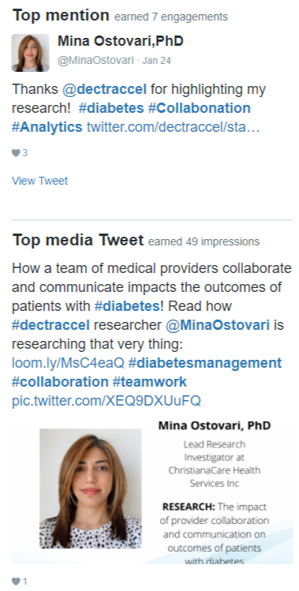
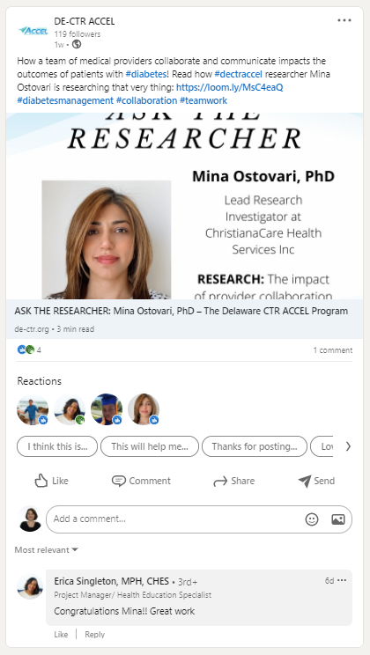
Importance of Dissemination/Social Sharing
Why it’s important: Showcase your work and accomplishment(s) on the ACCEL website, in the newsletter, and on social media to share with the world! It will be seen:
Newsletter Example
Twitter Example
LinkedIn Example
ACCEL website is for fellow researchers and the community
Enable networking with fellow researchers
Community can interface and understand the impact of ACCEL’s work
Full integration between the newsletter and ACCEL website
Avg. 431 opens/newsletter issue
Avg. 110 clicks/newsletter issue
Presence and posting across 4 main social media channels (including user/organization tagging and appropriate hashtags)
Twitter (avg. 432 impressions/tweet)
LinkedIn (Avg. 199.8 impressions; 117.6 unique impressions/twee)
Facebook & Instagram (avg. page/profile reach: 16)

Slide 47
Feel free to use this electronic logo if needed for posters
Thank you for your help in making the
ACCEL Program a success !!

