Slide 1
ACCELERATE HEALTH CARE
Session A: Platform Presentations
May 15, 2017
Delaware Clinical and Translational Research (DE-CTR)/ ACCEL
Community Engagement and Outreach Conference
www.de-ctr.org

Slide 2
Cindy Dodds, PT, PhD, PCS
Diane Gallagher, PhD
Marianne Jones, SLP-CCC
Notes:
Founded in 1824, The Medical University of South Carolina (MUSC) continues the tradition of excellence in education, research and patient care. MUSC educates and trains more than 3,000 students and residents in six colleges and has nearly 13,000 employees, including approximately 1,500 faculty members. As the state’s only academic health science center and largest non-federal employer in Charleston, the university and its affiliates have collective annual budgets in excess of $2.3 billion, with an annual economic impact of nearly $4 billion and annual research funding in excess of $250 million. MUSC operates a 700-bed medical center, which includes a nationally recognized children's hospital, the NCI-designated Hollings Cancer Center, a Level I trauma center, Institute of Psychiatry, more than 100 outreach locations across the state, and South Carolina’s only transplant center.

Slide 4
Disclosures
Speaker Name: Cindy Dodds, Diane Gallagher, Marianne Gellert-Jones Disclosure of Relevant Financial Relationships We have no financial relationships to disclose. Disclosure of Off-Label and/or investigative uses: We will not discuss off label use and/or investigational use in my presentation.

Slide 5
Acknowledgements
Work supported by
Institutional Development Award (IDeA) from the National Institute of General Medical Sciences of the National Institutes of Health under grant number U54-GM104941 (PI: Binder-Macleod)
APTA Foundation Pediatrics Research Grant under grant number 2015_2RG01

Slide 6
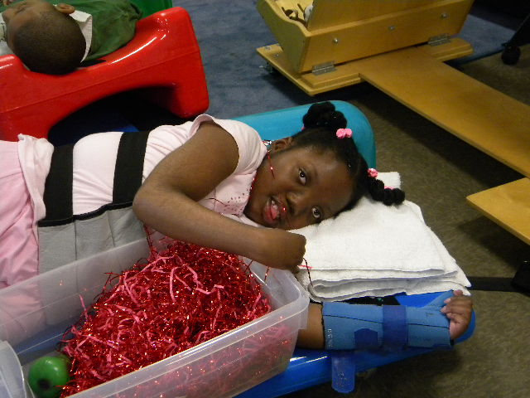
Introduction to Children with Severe Brain Impairment
Notes:
GMFCS, MACS, CFSF, EDCS level V
Dependent for mobility, ADLs, communications
Children with severe brain damage or severe CNS impairment
May also be described as severely disabled, medically complex, or considered to be in
a vegetative or minimally conscious state
4 percent of the 13 to 18 percent of children having special healthcare care needs

Slide 7
Pediatric Awareness and Sensory Motor Assessment
No ideal measurement instruments exist for assessing cognitive awareness and sensory motor behaviors of children with severe brain damage
Pediatric Awareness and Sensory Motor Assessment (PASMA) was created to measure and assess cognitive awareness in children with severe brain damage
Failure to develop valid assessment tools that measure the cognitive awareness of these children will diminish their quality of life (QOL) and participation

Slide 8
Research Questions
Does the PASMA demonstrate preliminary characteristics of a meaningful measurement tool?
For children with severe brain damage, do total scores on the PASMA correlate with total scores on the Pediatric Glasgow Coma Scale (PGCS)?
For children with severe brain damage, do changes in heart rate variability (HRV) responses correlate with observed sensory motor responses during administration of the PASMA?
Do the academic and community investigators achieve good to excellent inter-rater reliability values to support the community investigator’s ability to collect data for clinical and research purposes, and thereby achieve the capacity to function as an independent community investigator?

Slide 9
Purposes
To continue investigation of the PASMA’s construct and concurrent criterion validity by means of Rasch analysis and correlation with heart rate variability (HRV) and the Pediatric Glasgow Coma Scale (PGCS)
To train a Speech and Language Pathologist from HMS School for Children with Cerebral Palsy in reliable PASMA’s administration and interpretation

Slide 10
Methods
Design: Construct and concurrent validity of newly developed tool; Inter-rater reliability of CI and AI
Participants: 15 children with severe brain damage
• Between 3-21 years
• Medically stable
• Physician permission
• Parental consent

Slide 11
Methods: Tools
PASMA
5-minute observation period to document child’s common motor behaviors
Evaluation of sensory-motor responses across 5 sensory domains (i.e.,
olfactory, visual, auditory (including vestibular), gustatory, and tactile)
containing 29 items
Scoring is categorical
PGCS
Study comparative tool
Common clinically used measure for nonverbal children with acute traumatic
brain injury
Heart rate variability
Relationship between body function physiology and observed PASMA
responses (autonomic nervous system health)
Portable HRV monitor (Firstbeat Bodyguard 2)
Descriptive data
Corroborate scored observations

Slide 12
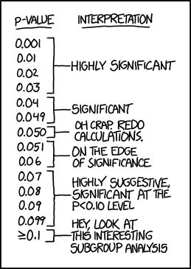
Methods: Statistical Analyses
Cohen’s kappa coefficient
Rasch analysis

Slide 13
Engagement Plan: Phase 1 Completed
IRB Approval
Community Investigator obtained informed consent and HIPAA from parents for study participation
Academic and community investigator collected PASMA data on 8 children attending HMS School from November 28 to December 9, 2016
Academic investigator trained community investigator in PASMA administration
Establish inter-rater reliability between the AI and CI following the PI’s data collection
Redcap app captures data

Slide 14
Inter-rater Reliability
Olfactory
100% agreement for 4 items
Summative olfactory domain score: ICC (single measure): 0.788
Vision
Kappa values from 0.331, 0.529 to 1.0
70-100% agreement
Summative visual domain score: ICC (single measure): 0.945
Auditory
Kappa values from 0.296 to 0.554
61.6-86.8% agreement
Summative auditory domain score: ICC (single measure): 0.675
Gustatory
Kappa values 0.307, 0.785, 1.0
70, 91, 100% agreement
Summative gustatory domain agreement: ICC (single measure): 0.696
Tactile
Kappa values 0.479, 0.655 to 1.0
80-100% agreement
Summative tactile domain score: ICC (single measure): 0.961
Notes:
Auditory 3 categories
0.296, 0.391, 0.435, 0.554
Gustatory: only 2 not 100 % (lip-gloss and anticipatory mouth opening)

Slide 15
Engagement Plan: Phase 2 and 3
Phase 2
CI collects data on 7 participants, mentored by academic investigator
Establish inter-rater reliability between the AI and CI following data collection lead by community investigator
Finalize PASMA items based on Rasch analysis and clinical expertise of academic and community investigators
Phase 3
Academic and community investigator will disseminate findings
HMS newsletter
Manuscripts submissions and acceptance to a peer-review journals

Slide 16
Our Collaborations
Communicate weekly with conference calls 1-2 month
Created Pre- and post-test surveys for HMS Feeding Training Program
Submitted 2 abstracts for AACPDM instructional courses and 1 accepted entitled “Ready to eat? Can training caregivers improve participation in feeding for children with cerebral palsy?”
2 Potential Grant Submissions
Notes:
NIH Phased Innovation Award for Mechanistic Studies to Optimize Mind and Body Interventions in NCCIH High Priority Research Topics (R61/R33)
Private Foundation for written and video recorded feeding training

Slide 17
May we answer your questions?

Slide 18
Increasing Access to Empirically-validated Interventions for Autism Spectrum Disorder: Dissemination of PEERS into Community Health Settings
Laura Dewey, PhD, Academic Investigator
Cathy Rose, LPCMH, Community Investigator
Brian Freedman, PhD, Mentor
Presented at ACCEL Community Research Exchange
May 15, 2017

Slide 19
Background
Autism spectrum disorder (ASD) is a lifelong neurodevelopmental disorder marked by significant impairment in social communication and interaction and presence of restricted, repetitive patterns of behaviors and interests.
A recent needs-assessment of families affected by ASD in the state of Delaware identified a critical need for social skills interventions among parents of children with ASD (Rhoton & Ekbladh, 2012; University of Delaware, 2013).
Need for community-based interventions

Slide 20
Engagement Plan
Build capacity for social skills interventions for ASD for adolescents in community treatment settings across the state
Clinicians from Nemours will partner with Delaware Guidance Services for Children and Youth, Inc (DGS), a community mental health agency, in order to provide social skills group intervention to adolescents and their caregivers in an outpatient clinic setting.
Engagement initiated by Director of DGS in an effort to provide more training for staff and services to families affected by ASD
Support from Autism Delaware, a community partner, was confirmed
The Program for the Education and Enrichment of Relational Skills (PEERS), a social skills group program developed at UCLA (Laugeson and Frankel, 2010), is used
clinic-based model that includes a concurrent parent group throughout the one-hour per week, 14 week intervention
A certified PEERS trainer (Susan Veenema, M.Ed.) from the University of Delaware provided two-days of formal education on PEERS to the DGS staff in November 2016

Slide 21
Aims
1. Build capacity for ASD interventions by providing formal education to clinicians in PEERS
2. Assess caregiver and adolescent outcomes following participation in PEERS regarding social skill symptoms, parenting stress, and family quality of life

Slide 22
Methods
Aim 1:
1. 12 DGS clinicians will attend PEERS training
2. Clinicians will complete pre and post surveys assessing their perception of implementing a social skills group intervention for families affected by ASD
Aim 2:
1. Up to 80 families will be recruited to participate in PEERS at 4 DGS locations in spring 2017
2. Caregivers will complete pre and post surveys assessing parenting stress, adolescent social skills, and family quality of life

Slide 23
Update
Aim 1:
1. ASD/PEERS training for DGS staff completed in November 2017
ASD training provided by Drs. Dewey and Freedman; PEERS training provided by Ms. Veenema
Over 25 staff from DGS participated, 4 LEND trainees, 2 psychology residents
2. Clinicians will complete pre and post surveys assessing their perception of implementing a social skills group intervention for families affected by ASD
In progress
Aim 2:
1. Up to 80 families will be recruited to participate in PEERS at 4 DGS locations in spring 2017
Group A: Lewes (9 families), Dover (7 families), Seaford (4 families)
Group B: Lewes and Seaford planned, Dover coming
Difficulties with recruitment and staff retention; no Wilmington group
2. Caregivers will complete pre and post surveys assessing parenting stress, adolescent social skills, and family quality of life
In progress

Slide 24
Relevance
Will create opportunities for the expansion of evidence-based social skills interventions for ASD in community settings.
The data from a community mental health setting can be compared to the data from the hospital-based PEERS groups and the school-based PEERS groups to determine differences in outcomes.
As PEERS grows, randomized controlled trials can be conducted between PEERS and other interventions, such as family-based Cognitive Behavior Therapy (CBT).
Additionally, other community partners with investment in ASD can be research collaborators, such as Autism Delaware.
Overall, the dissemination of PEERS will serve to bridge the gap between underserved regions and populations.

Slide 25
Assessing Delaware Parents’ Knowledge, Attitudes, & Preferences about LARC for Teens using Participatory Action Research
Aniah Coley, BS
Jane Bowen, MHS
Krishna White, MD, MPH

Slide 26
Disclosures
No financial disclosures
Work supported by an Institutional Development Award (IDeA) from the National Institute of General Medical Sciences of the National Institutes of Health under grant number U54-GM104941 (PI: Binder-Macleod).
Notes:
Dr. White is upstream trainer

Slide 27
Background
Teen pregnancy continues to be a problem generally in the United States and specifically in Delaware
46.8% of Delaware teens have had intercourse
72.6% of Delaware’s sexually active teens did not use any form of hormonal birth control
Delaware teens have the 2nd highest teen abortion rate in the US
Notes:
70/1000 Wilmington females aged 15-19 gave birth compared to 33.7/1000 in the US

Slide 28
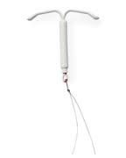
Background
Long-acting reversible contraception or LARC is the most effective form of birth control in all ages
In October of 2014 the AAP recommended that LARC be considered the first line contraceptive choice for adolescents
Notes:
Many places where Delaware teens receive reproductive health care do NOT currently provide LARC (school based health centers, ARC, pediatrician offices)
Practitioners are concerned about administration of LARC in teens without parental knowledge or consent (although this is legal in Delaware)

Slide 29
Background
Delaware CAN: effort by the Delaware division of public health to reduce unintended pregnancy in the state of DE
Partnership with nonprofit upstream USA
Goal is to increase access to contraception
http://www.upstream.org/delawarecan/
Notes:
Contraceptive Access Now
This comprehensive, statewide plan is increasing access for all women to the full range of contraceptive methods, including the most effective, IUDs and implants. Upstream USA is providing training, technical assistance, and quality improvement to all publicly funded health centers and the largest private providers in the state. Additionally, a consumer marketing campaign and rigorous evaluation will increase demand and measure outcomes. Goal is to improve public health by creating an environment where the women of Delaware can achieve their goals and become pregnant only if and when they want to.

Slide 30
Objectives
Reveal current knowledge, attitudes and beliefs that Delaware parents of teens have about LARC
Understand parental preferences about use and administration of LARC
Disseminate results to health care providers, policy makers and educators, and engage them in efforts that decrease barriers to LARC for teens

Slide 31
Methods
Participatory Action Research: research approach that emphasizes participation of community members with a focus on actionable data
Notes:
Involved community researchers to allow funds and knowledge to flow to the community.
Also allows the community input to influence study decisions.

Slide 32
LARC PAR TEAM
Krishna White, MD, MPH, FAAP: Principal Investigator
Jane Bowen, MHS: Community Investigator
Aniah Coley: Study Coordinator
Jennette Fennimore: Community Researcher
Andrea Miller: Community Researcher
Evelyn Diaz-Camacho: Community Researcher
Denise Fuller: Community Researcher
Jessica Walters, MD: 3rd year Pediatric Resident
Sarah Vater, MD: 2nd year Pediatric Resident

Slide 33
Methods
Phase I
Recruit community researchers
Stakeholder interviews
Phase II
Part 1: Focus groups
Part 2: Design statewide electronic survey
Presented results in variety of settings
Phase III
Distribute electronic survey to parents of teens

Slide 34
Methods – Phase II Part 1
Focus Groups
4 Focus Groups held (2 White, 1 Black, 1 Latina)
Led by 1-2 community researchers who matched ethnicity of participants
36 question semi-structured discussion guide that was designed using the Integrative Behavioral Model
Participants received dinner and $55 gift card
Notes:
Integrative behavioral model: 5 components that directly affect behavior
Most important determinant is intention b/c without intention to do so an individual is unlikely to carry out a behavior. Behavioral intention is determined by attitude (favorable, unfavorable, emotional response, beliefs about outcomes), perceived norms (social pressure) and personal agency (self-efficacy/perceived power)
An individual needs the knowledge and skills to carry out the behavior.
The behavior should be salient to the individual (that is, important to the person and at the forefront of their thoughts).
There should be few or no environmental constraints that make behavioral performance difficult.
With experience performing the behavior, the behavior will become habitual for the individual.
Recruited focus groups from social networks, affinity resource groups of hospital, workforce development program

Slide 35
Methods – Phase II Part 1
Focus Group Data Analysis
Two researchers used a values coding process to code data independently (manually and with NVivo 8)
Notes:
The researchers then met with the research team to identify emerging themes and resolved discrepancies by consensus

Slide 36
Methods – Phase II Part 2
Redcap survey in recruitment
Designed questions from focus group themes
Plan to recruit participants via flyers in various locations around Delaware
Participants will receive a $10 gift card for completing the survey
As of today 138 parents have completed survey

Slide 37
Focus Group Results – Demographics of Parents
Gender | 90% Female | 10% Male
Education | 27% Advanced degree | 22% College | 20% High school and some college
Race | 50% White | 30% African American | 20% Hispanic
Religion | 74% Christian | 24% No preference
Residence | 70% Suburban | 26% City | 100% New Castle County
Notes:
46 total parent participants
Average age of teen 14.6 (9-20 yo)

Slide 38
Focus Group Results – Demographics of Parents
Income | 33% >$100,000 | 20% $50-99,000 | 26% $25-49,000 | 17 % < $25,000
Insurance | 78% Private | 22% Medicaid
In Healthcare | 72% No | 18% Yes
Sexually active teen | 24% Yes | 28% Unsure
Parent’s BC Method | 28% Condoms | 22% Sterilization | 20% Other | 7% IUD

Slide 39
Results - Parent Responses
Key themes
1. Importance of prevention of sexually transmitted infections
2. Need for access to confidential birth control for teens of other parents but not necessarily theirs
3. Need for a clean, sterile environment with experienced personnel
4. Double standard between parents of teen boys and girls
Notes:
Preventing STDs was just as important as preventing teen pregnancy
Differences between boys and girls- Different consequences, Different acceptance of sexual activity, More contraceptive options for girls, Parent of teen girl has more responsibility

Slide 40
Results – Parent Responses
“I have a son and a daughter. My views and concerns are very different because I have to worry about the possibility of her getting pregnant but with him, I have to show up at somebody else and say, “Oh! Sorry about that.”

Slide 41
Results - Parent Responses
“You got just everything now so I'm not privy to all these birth controls. I tried Depo, I blew up, but I'm like, if it ain't natural and what should be stopping your cycle when that's a God-given thing and that should come naturally. They got pills, they got stuff to go on the arm, then you can see it and I don't know enough about it that I would want my child to try this.”
Notes:
Parents could list all methods of birth control including LARC but were not familiar with all methods

Slide 42
Results - Parent Responses
Choosing Birth Control
Safety and Side effects
Opinion of health care provider
Ease of Use
Future fertility
Stopping Cycles
Weight gain
STD prevention
Familiarity
Notes:
Factors important for choosing a method

Slide 43
Results - Parent Responses
No worries
Hormonal/body changes
Risky behavior
STIs
Ease of Use
Side effects
Effective
LARC
Disadvantages
LARC
Advantages

Slide 44
Results - Parent Responses
“I do want to make a statement. I’ve got nothing against you that you are facilitating this session. So I’m always suspicious at nature, so these questions that if Nemours is sponsoring it gives me the impression, that Nemours is trying to target the Hispanic community for LARC. Then what's the underlying agenda there? Is it that we’re overpopulating and there are too many kids coming out of our community, so let’s stop the population, so let’s give them LARC? Seriously I get very suspicious at first. I have read a lot of stories.”
Notes:
Racial/ethnic/religious concerns
No mention of religion
Black focus group – 1 participant mentioned another threat to population growth (in addition to gun violence)
Latina focus group – 1 participant mentioned concern about her community being targeted by Nemours and pharmaceutical companies

Slide 45
Conclusions
Knowledge
Not familiar with all birth control methods
Attitudes
Concerns about newer/unfamiliar methods
STD/HIV prevention
Parents want communication/involvement
Beliefs
Most parents believed confidential services were for kids with out of touch parents
Notes:
Knowledge
Parents could list but were not familiar with all methods
Knowledge gap for LARC
Most parents were unable to distinguish between specialties for administration of LARC but would turn to PCP for advice
Attitudes
Most parents were receptive to birth control for teens in all health care settings but had concerns about newer/unfamiliar methods
STD/HIV prevention is just as important as pregnancy prevention
Parents want communication/involvement with birth control decisions but understand need for confidential services
Beliefs
Most parents believed confidential services were for kids with out of touch parents (and they were not like that)

Slide 46
Future Directions
Identify solutions to major barriers of LARC use
Advocate for funding of programs that enable adolescents to safely and easily access to LARC
Ensure through evidence-based research that STI rates are not increasing with increased use of LARC

Slide 47
LARC PAR TEAM
Krishna White, MD, MPH, FAAP: Principal Investigator
Jane Bowen, MHS: Community Investigator
Aniah Coley: Study Coordinator
Jennette Fennimore: Community Researcher
Andrea Miller: Community Researcher
Evelyn Diaz-Camacho: Community Researcher
Denise Fuller: Community Researcher
Jessica Walters, MD: 3rd year Pediatric Resident
Sarah Vater, MD: 2nd year Pediatric Resident

Slide 48
Questions

Slide 49
Evaluation of a homebound patient cohort for knowledge and interest in palliative care and reported well-being
Principal Investigator: Linsey O’Donnell, DO
Community Investigator: Naomi Stump
Research Assistant: Leslie Stalnaker, MPH
HPM Fellow: Amanda Cooper, MS, DO
Christiana Care Health System

Slide 50
Definition of Palliative Care
Palliative care is specialized medical care for people with serious illnesses.
It focuses on providing patients with relief from the symptoms, pain, and stress of a serious illness—whatever the diagnosis.
The goal is to improve quality of life for both the patient and the family.
Palliative care is provided by a team of doctors, nurses and other specialists who work together with a patient’s other doctors to provide an extra layer of support.
It is appropriate at any age and at any stage in a serious illness and can be provided along with curative treatment.
www.capc.org

Slide 52
Cost of Care
Medical spending in the U.S. $3.06 trillion in 2014
Costliest 5% account for 50% of all health care spending
14% of Americans with both chronic conditions and functional limitations account for 56%
More important is cost to the patient and family
Nearly 70% of people die in hospital, NH or facility
7/10 people identify they would like to die at home
Only 25% do….
CDC 2005 Data

Slide 53
Cost of Care
More than 80% of patients with chronic disease want to avoid hospitalization and intensive care when dying
Hospitalizations during the last 7 months before death remain high
ICU stays have been increasing
7/10 Americans die from chronic disease and more than 90 million Americans live with at least one chronic disease
Only 20-30% of Americans report having an advance directive, and when they do physicians are often unaware of their preferences
Only 25% of physicians knew their patients had an AD on file
CDC 2005 Data, Dartmouth Atlas of Health Care 2005, capc.org

Slide 54
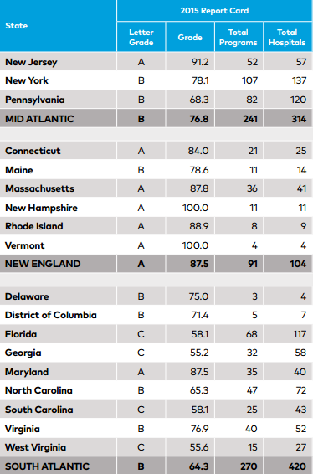
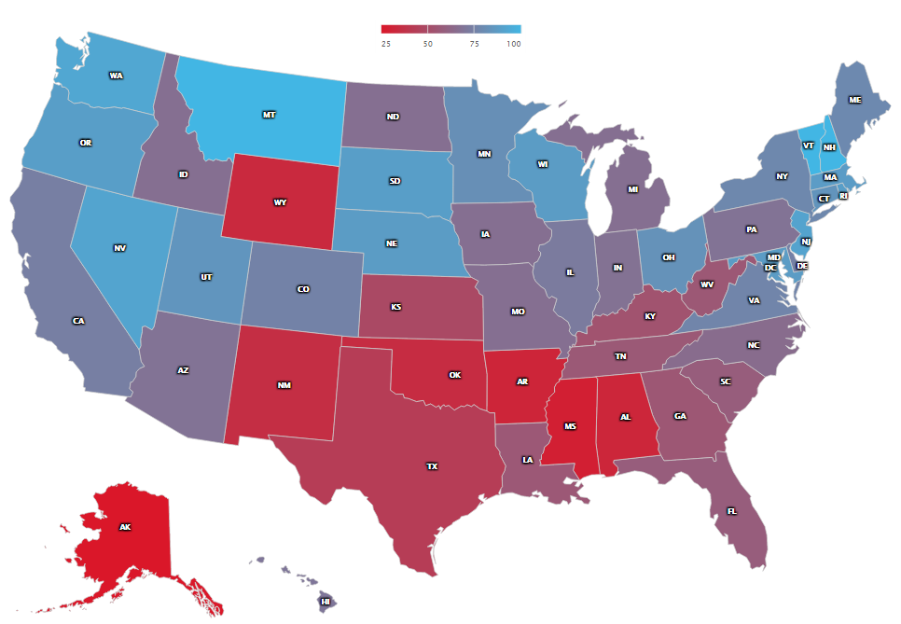
Palliative Care in the USA
Estimates show that between 1 million and 1.8 million patients admitted to U.S. hospitals each year could benefit from palliative care, but are not receiving it.
Statistics and figures retrieved from the Center to Advance Palliative Care at the National Palliative Care Research Center - https://reportcard.capc.org/

Slide 55
Visiting Nurse Association of Christiana Care
Largest home health care provider in Delaware - serving the state since 1922
2 branches:
New Castle County: located in New Castle
Kent/Sussex Counties: located in Camden
Average of 1,800+ visits/day = 657,000+ visits/year
Total of 635 clinical staff
300 home health aides
235 direct care clinicians: skilled nursing, OT, PT, SLP, MSW, MCH

Slide 56
Research Questions
What is the preference, readiness, or desire for palliative care, skilled nursing care, or hospice care within our chronically ill homebound patient population in northern New Castle County?
What is the prevalence of advance care planning in this community of homebound patients?
At what degree of functional status or level of quality of life does palliative care become valuable in the view of patients in this community?

Slide 57
Hypotheses
As quality of life and functional status decline, patients will be more inclined to choose palliative care services or hospice services as desirable.
Greater than 30% of homebound patients will have completed an advance directive.
Knowledge of palliative care in this homebound community is discordant with interest in or desire for palliative care.

Slide 58
Materials
22-question survey
16 Questions - Missoula-VITAS Quality of Life Index
2 Questions - Knowledge of palliative care
3 Questions - Advance Care planning
1 Question – Ranking interest in care programs
Home Nursing, Palliative Care, and Hospice
Karnofsky Performance Status Scale
Goal of surveying 350 individuals/caregivers

Slide 59
Methods
Participants are all residents of New Castle County, DE (excluding Middletown and all areas south of C&D Canal)
Surveys obtained
In person by VNA nurses
In person by research investigators
Over phone

Slide 60
Missoula-VITAS Quality of Life Index
5 Domains of Quality of life
Symptom
Function
Interpersonal
Well-being
Transcendent
3 questions per domain
Assessment
Satisfaction
Importance
Global rating of QOL
Well-being
My affairs are not in order; I am worried that many things are unresolved
I am more satisfied with myself now than I was before my illness
It is important to me to be at peace with myself

Slide 61
Karnofsky Performance Status Scale
80-100% Able to carry on normal activity and to work No special care needed
50-70% Unable to work Able to live at home and care for most personal needs Varying amount of assistance needed
0-40% Unable to care for self Requires equivalent of institutional or hospital care Disease may be progressing rapidly
Karnofsky Performance Status Scale
100: normal no complaints, no evidence of disease
90: Able to carry on normal activity; minor signs of symptoms of disease
80: Normal activity with effort; some signs or symptoms of disease
70: Cares for self; unable to carry on normal activity or to do active work
60: Requires occasional assistance, but is able to care for most of his personal needs
50: Requires considerable assistance and frequent medical care
40:Disabled; requires special care and assistance
30: Severely disabled; hospital admission is indicated although death not imminent
20: Very sick; hospital admission necessary
10: Moribund; fatal processes progressing rapidly
0: death
To determine homebound patients’ knowledge about palliative care
To assess the prevalence of advance directive completion in this population
To identify which type of in-home care program most interests patients
To determine and compare self-reported and objective measures of patient well-being and illness burden
To determine homebound patients’ knowledge about palliative care
To assess the prevalence of advance directive completion in this population
To identify which type of in-home care program most interests patients
To determine and compare self-reported and objective measures of patient well-being and illness burden

Slide 62
Demographics
Female
Male
25
(50%)
25
(50%)
Non-Hispanic
Black
Non-Hispanic
White

Slide 63
Results – Quality of Life
How would you rate your overall quality of life?
Worst Possible
Poor
Fair
Good
Best Possible

Slide 64
Results – Quality of Life
Mean QOL score: 17.6 ± 4.3
Minimal variance in mean score when comparing race and sex
Oldest age group (86+ years) had highest mean score
Those who reported global QOL as “best possible” had highest mean score
By Domain:
Lowest – Function and Well-Being
Highest – Transcendent
Notes:
Blacks slightly higher than Whites, Females slightly higher than males

Slide 65
Results – Functional Status
KPSS Categories:
Moderate Functional Status (KPSS 50-70): 41
Low Functional Status (KPSS 0-40): 9
Functional Status vs. Quality of Life
Participants with low functional status had higher mean QOL than those with moderate functional status: 18.7 vs 17.4
Sole participant who reported her global QOL as “worst possible” also had lowest QOL score and low functional status

Slide 66
Results – Palliative Care
Knowledge: 24.0% (12 out of 50) stated that they knew what PC was when asked
Interest: 82.0% (41 out of 50) stated that they would be interested in PC after hearing the definition
Ranking:

Slide 67
Results – Advance Care Planning
Talked to doctor or loved one about wishes
Selected a POA or decision maker
Completed an advance directive/living will

Slide 68
Next steps
Hypothesis generating work
Future questions
How many AD are accessible in the hospital medical record
Further explore palliative care models that may best serve the patient population
Examine impact of caregiver burden on pt/caregiver QOL results in our population
Quality of life can be excellent despite physical and functional impairment
Providing primary and specialty palliative care is essential to help our patients have the best possible quality of life and to honor their wishes at the end of life

