Slide 1
ACCELERATE HEALTH CARE
Platform Presentations – Session A
March 12, 2018
www.de-ctr.org/community
www.dhsa.org

Slide 2
Consultation for Addiction Consult Services: Identifying Characteristics Associated with Substance Use Disorder Treatment Attendance and Retention
Alexa J. Meinhardt, BA
Tanya Bracey, MS, CADC

Slide 3
Disclosures
The presenters have no personal or financial conflicts of interest.

Slide 4
Addiction Consult Service
Opioid misuse/abuse is a growing epidemic
Over 15% of hospitalized patients are diagnosed with a substance use disorder¹
Hospital as a “reachable moment” to promote community treatment
Physician consultation led by Dr. Terry Horton
¹Center for Health Information and Analysis (2016). Behavioral health & readmissions in Massachusetts acute care hospitals. Commonwealth of Massachusetts.

Slide 5
Project Engage
Early intervention and referral to SUD treatment
Engagement Specialists
Peers in recovery
Motivational interviewing
Coordinate discharge plan with community treatment facility
https://christianacare.org/services/behavioralhealth/project-engage/

Slide 6
Methods
Retrospective analysis
Patients admitted to Christiana Care and seen in SUD consultation
November 2015 to January 2018
Objective:
Describe patients assessed by Christiana Care’s physician-led consultation service
Determine whether outcomes differ based on gender
Outcomes: leaving against medical advice (AMA) & community treatment attendance

Slide 7
Demographics
350 records of 299 unique patients
 | All n=299 |  | Male n=166 | Female n=133
Age, mean | 42.3 |  | 44.8* | 39.1*
Race
White, % | 73 | 68 |  | 79
Black, % | 22 | 26 |  | 18
Ethnicity
Hispanic or Latino, % | 6 | 6 |  | 7
NOT Hispanic or Latino, % | 91 | 93 |  | 89
*p<0.001

Slide 8
Patient Characteristics
 | All n=299 | Male n=166 | Female n=133
Mental Health Diagnosis**, % | 50 | 43* | 59*
Depression, % | 27 | 22* | 34*
Anxiety, % | 24 | 17* | 32*
Bipolar Disorder, % | 16 | 10* | 23*
Drug of Choice**
Heroin, % | 83 | 82 | 83
Crack and/or Cocaine, % | 28 | 24 | 33
Opioid Pain Meds, % | 17 | 17 | 16
Alcohol, % | 15 | 19* | 10*
**Not mutually exclusive
*p<0.05

Slide 9
Outcomes
 | All n=299 | Male n=166 | Female n=133
Left AMA, % | 16 | 13 | 20
Treatment
Accepted community treatment, % | 64 | 63 | 64
No/Not Interested/Other, % | 29 | 30 | 29
Currently in treatment, % | 4 | 4 | 5
Transferred to another facility, % | 3 | 4 | 2
Attend Treatment (among those who accepted community treatment [n=190])
Yes, % | 69 | 68 | 72
Still Attending at 30 days (among those who accepted community treatment [n=190])
Yes, % | 53 | 53 | 52

Slide 10
Post-Discharge
Characteristics of post discharge patients from medical setting
Streamline process to access treatment and capitalize on the “reachable moment”
Future plans – “Warm hand-offs”

Slide 11
Best Practices
Clear communication between the hospital and providers
Agreement on a system that closes the gap between services
Focus on the motivators for change to sustain momentum for patient

Slide 12
Conclusions
Gender-based differences provide insight to subgroups of patients who would benefit from specific interventions
Heroin-using medical service patients seen by the consultation service had high transition rates to community treatment
High rates of treatment attendance
Results consistent with literature
Hospital as a “reachable moment”

Slide 13
Future Directions
Investigate additional outcomes
Hospital readmission at 90 days
Link data with opioid overdose fatalities from Delaware Medical Examiner’s Unit
Repeat analysis as more patients are seen in consultation
Gender-specific measures should be explored to improve hospital retention & transitioning to community treatment

Slide 14
Acknowledgments
This project was supported by the Seema S. Sonnad Memorial Fund for Young Investigators Award and the Value Institute at Christiana Care.
Special thanks to the project members: Claudine Jurkovitz, MD, MPH; Kimberly Williams, MPH; Beverly Wilson, MS; Cheryl Botbyl; Terry Horton, MD; and the Project Engage team.

Slide 15
The Value Institute
Thank you!
Questions, comments, suggestions?

Slide 16
Provider and parent reactions to changes in the nutritional quality of food served in childcare settings in Delaware: a mixed methods study
Nicole Slesinger, MS(c);
Laura Lessard, PhD, MPH;
Emily Toal &
Alexa Hirschberg
Department of Behavioral Health & Nutrition
Notes:
Provider and parent reactions to changes in the nutritional quality of food served in childcare settings in Delaware: a mixed methods study
Background: The majority of young children (under age 5) in the United States spend time in non-parental care settings such as childcare centers. Recent changes to the Child and Adult Care Food Program (CACFP) require more healthful food to be served in these settings. This is in response to concern over the nutritional quality of the foods that were served and a growing focus on childhood obesity. Little research has explored how childcare staff explain these changes to parents and parent attitudes towards the healthier menu.
Objective: To explore how providers discuss the CACFP changes with parents and their perception of parent attitudes towards the changes.
Methods: A survey was administered to all CACFP providers in Delaware during fall 2017 (n=154), assessing their expectations of parent response to the changes. From these surveys, purposive sampling was used to create a panel of providers to participate in a four month qualitative follow-up study exploring their experience implementing the new meal pattern (n=7).
Results: Prior to the changes taking place, over 87% of survey respondents anticipated that parents of children at their facility would support the new changes. Interviews showed that few centers actively prepared parents for the new food changes. Of those that did, parents shared concern for the types of food offered and took a period of time to adjust to the regulations.
Conclusions/Relevance: The findings have wide implications for health policy, suggesting that more attention be paid to communicating policy changes to parents.

Slide 17
Presentation Overview
Background:
Nutrition in Child Care Settings
Child and Adult Care Food Program (CACFP)
Methods
Results
Quantitative (survey)
Qualitative (interviews)
Conclusions
Notes:
Intros (LL) 1 min
Background (LL): 2 mins
Methods: (LL) 2 mins
Results survey (LL) 2 mins
Results interviews (NS) 3 mins
Conclusions 1 min

Slide 18
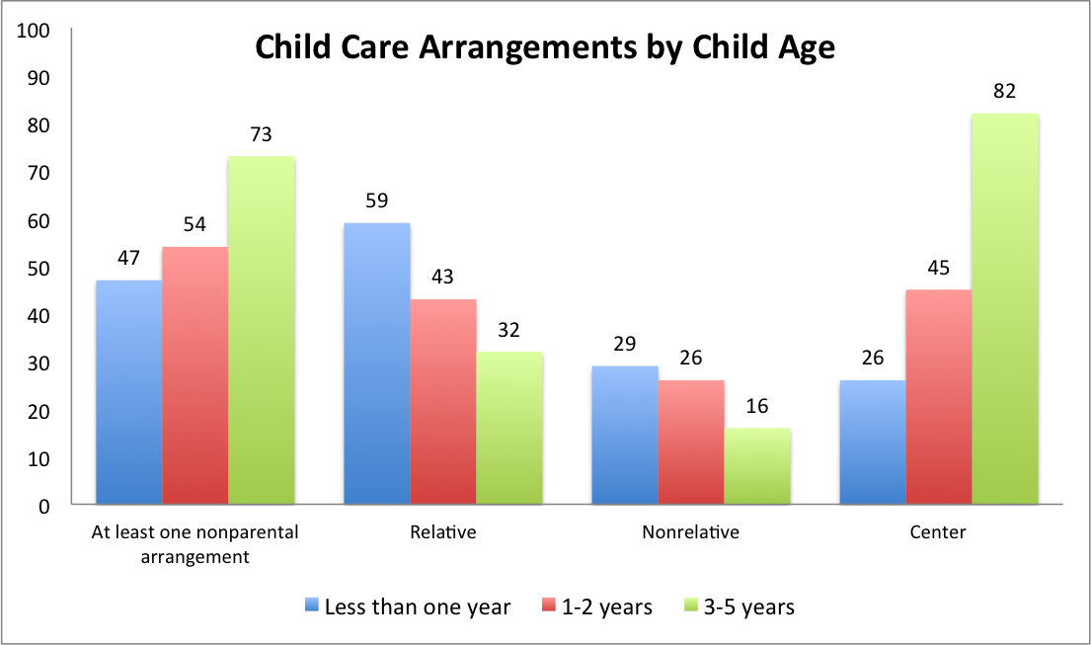
Child Care Participation
Corcoran , L., and Steinley, K. (2017). Early Childhood Program Participation, From the National Household Education Surveys Program of 2016 (NCES 2017-101), National Center for Education Statistics, Institute of Education Sciences, U.S. Department of Education. Washington, DC.
Notes:
Corcoran , L., and Steinley, K. (2017). Early Childhood Program Participation, From the National Household Education Surveys Program of 2016 (NCES 2017-101), National Center for Education Statistics, Institute of Education Sciences, U.S. Department of Education. Washington, DC.

Slide 19
Nutrition in Child Care - CACFP
The Child and Adult Care Food Program (CACFP) is a federal program that provides reimbursement for meals served to low-income children in child (and adult) care settings
The Meal Pattern describes the types and quantity of foods that must be served to children in order to be reimbursable
The Meal Pattern was changed (effective Oct 1, 2017) for the first time since the program began in 1968
Notes:
more than 4.2 million children and 130,000 adults receive nutritious meals and snacks each day; 923,000 in delaware in 2014
Under the new child and adult meal patterns, meals served will include a greater variety of vegetables and fruit, more whole grains, and less added sugar and saturated fat.

Slide 20
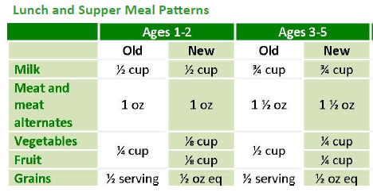
Meal Pattern Change:
Meals now include a greater variety of vegetables and fruit, more whole grains and less added sugar and saturated fat
https://www.fns.usda.gov/cacfp/meals-and-snacks

Slide 21
Meal Pattern Change:
Meals now include a greater variety of vegetables and fruit, more whole grains and less added sugar and saturated fat
https://www.fns.usda.gov/cacfp/meals-and-snacks

Slide 22
Research Questions
What are provider perceptions of parent attitudes toward the changes?
In what ways, if any, are CACFP changes communicated to parents?
What are parent reactions to the changes?
Notes:
To explore how providers discuss the CACFP changes with parents and their perception of parent attitudes towards the changes.

Slide 23
Methods - Overview
Mixed Methods study used both quantitative (survey) and qualitative (interview) methods

Slide 24
Part 1: Quantitative survey with CACFP providers in Delaware
Administered to all attendees at a required, in-person training for CACFP providers (up to 2 per facility) in September 2017 (n=154)
Survey Items (Strongly Disagree → Strongly Agree):
Parents of children at my facility/facilities will support these new changes
I am concerned about giving parents information regarding the new guidelines.

Slide 25
Part 2: Qualitative interviews
Seven participants from the survey were selected to participate in four monthly interviews beginning in October 2017
Interview questions focused on communication with parents and parent reactions to the changes
How did you let parents know about the menu changes?
What type of feedback have you received from parents about the changes, if any?

Slide 26
Analysis
Part 1: Surveys
Data were entered into a spreadsheet, and analyzed using frequencies
Part 2: Interviews
Interviews were recorded (with permission) and recordings were reviewed for themes, which were discussed within the research team. Illustrative quotes were chosen for each theme.

Slide 27
Survey Results
 | Strongly Disagree | Somewhat Disagree | Somewhat Agree | Strongly Agree
 | Number of responses (percentage of total)
Parents of children at my facility will support these new changes | 7 (4.7%) | 12 (8.0%) | 66 (44.0%) | 65 (43.3%)
I am concerned about giving parents information regarding the new guidelines | 69 (46.6%) | 48 (32.4%) | 22 (14.9%) | 9 (6.1%)

Slide 28
Survey Results
 | Strongly Disagree | Somewhat Disagree | Somewhat Agree | Strongly Agree
 | Number of responses (percentage of total)
Parents of children at my facility will support these new changes | 12.7%
I am concerned about giving parents information regarding the new guidelines |  |  | 21%

Slide 29
Preliminary Interview Results
Many providers did not directly share the meal pattern changes with parents or were already following the majority of the changes
Many parents did not notice any change in the menus
There was no requirement to share information with parents and many administrative staff left the option to the teachers
Notes:
The majority of parent feedback derives from feeding infants a sufficient amount of food compared to what they feed their children in the home

Slide 30
Preliminary Interview Results
Some providers reported changes in the foods children bring to the center and/or an increase in child willingness to try new foods
“Now we will see a kid walking in with an apple in the morning versus the chips they used to bring in or the sugary drink they used to be drinking.”
“I think when the kids come in here and they are not interested in eating at home but when they get into the family style eating, they see their friends eating and they see their friends eating, they start eating as well and that’s a success for the parents.”
Notes:
Ns to insert

Slide 31
Conclusions
Providers were not overly concerned with parent reaction to the meal pattern changes
“Everyone knows we participate in this program so they know they have to go along with it.”
Limited communication occured between providers and parents around the changes
Some positive impacts on children and families were reported
Notes:
NS

Slide 32
Acknowledgements & Questions
THANK YOU to Aimee Beam and Ruth Uhey from the Delaware Department of Education for their collaboration and support
Nicole Slesinger, MS (c)
Laura Lessard, PhD, MPH : LLessard@udel.edu
And our wonderful team members: Emily Toal and Alexa Hirschberg

Slide 33
Nora Katurakes, RN, Pat Swanson, RN, Heather Bittner-Fagan, MD , Margot Savoy, MD, Zohra Ali-Khan Katts, MS., Diana Dickson-Witmer, MD, Ramya Varadarajan, MD, and Jennifer Sims-Mourtada, PhD.
Reducing health disparities in breast cancer through community engagement

Slide 34
The Breast Cancer Research Program at HFGCCRI
Mission: To establish a breast center of excellence that uses our collective energies to promote evidence-based breast cancer research, improve lives of breast cancer patients, and, eliminate disparities in breast cancer outcomes for all Delawareans.
Medical Expertise
Surgical Oncology
Medical Oncology
Radiation Oncology
Genetic Counseling
Outreach
Scientific Expertise
Immunology
Molecular biology
Nanotechnology
Chemical Engineering
Biomedical Engineering

Slide 35
Breast Cancer in Delaware
Triple Negative Breast Cancer
Delaware is among the states with high incidence of TNBC , an aggressive form of breast cancer with no targeted treatments. (JNatl Cancer Inst (2015)107(6):djv048)
Health disparity
Mortality is higher in African Americans than Caucasians, nationally and statewide.
Recent data show an increase in incidence nationally and statewide in African Americans.
African Americans more likely to have triple negative breast cancer

Slide 36
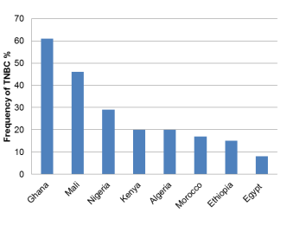
TNBC in African Americans
Is it Genetic?
Hereditary mutations are reported in up to 10-15% of TNBC across the board, but may be up to 25% in African American patients under 60.
High rates of TNBC in West African populations

Slide 37
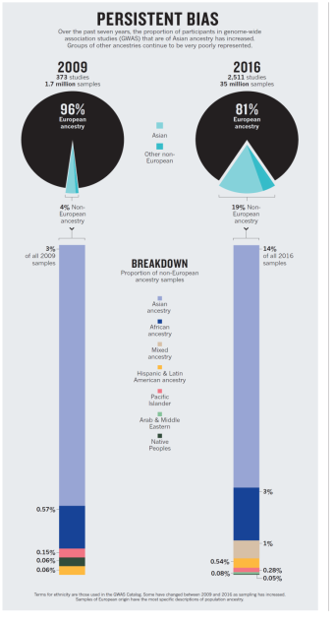
Out of 35 million samples from 2511 genetic studies, African Americans only make up 2% of samples.
2%
0.42%

Slide 38
Increasing Participation of African Americans in Genetic Counseling
African Americans have much lower rates of genetic testing than Caucasians
African Americans are under represented in variant analysis
Our data shows that although African Americans make up 63% of TNBC patients that are eligible for genetic testing in Delaware, they account for less that 15% of TNBC patients within the state who undergo genetic counseling.

Slide 39
Addressing Breast Cancer Disparities in Delaware: Community Research Advisory Board (CRAB)
15 founding members
Breast cancer survivors
Members of the medical community
Members of the African American Community

Slide 40
CRAB Goals 2017-2018
Dissemination of information on TNBC, genetic counseling and breast cancer prevention
Increasing the participation of AA women in genetic counseling, clinical trials and translational research

Slide 41
A tool kit for TNBC
Presentation to be given by members of the community at various local events
Train the trainer orientation
Speaker notes
Frequently asked questions
Video of presentation for certain events
Supplemental material with information about:
Genetic counseling
Breast cancer subtypes
ACS sheet on TNBC
Breast cancer prevention
Determining your breast cancer risk

Slide 42
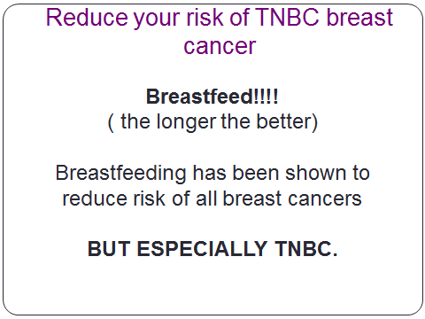
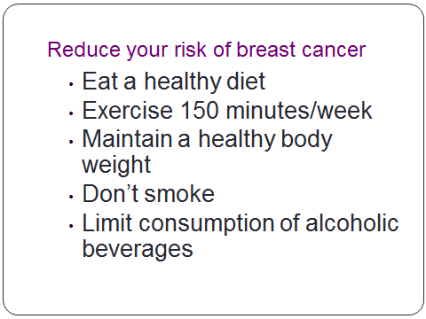
A Tool-Kit for TNBC-BCRP Version

Slide 43
The story of BRENDA

Slide 44
A Tool-Kit for TNBC-CRAB Version

Slide 46
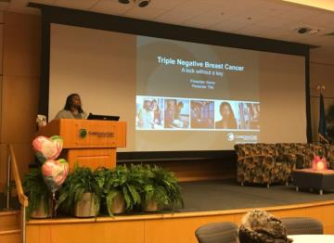
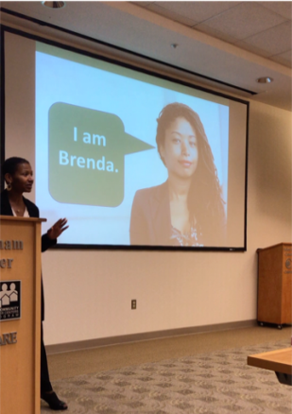
Pilot sessions
Presented to approximately 70 community members at 2 events
Feedback
Pre-and post test
Positive feedback
Need to be more sensitive when giving information about TNBC
Recruited 15 volunteers from the community to serve as trainers or champions

Slide 47
Next steps
Complete Train the Trainer sessions
Integrate the tool-kit into community events
Collect feedback and identify potential barriers and strategies to improve to breast cancer prevention and participation of African Americans in our catchment in genetic testing and research

Slide 48
Conclusions
Involvement of stakeholders significantly altered the approach for dissemination of information about triple negative breast cancer
CRAB and community presentations can serve as a method to establish relationships and obtain feedback regarding areas research and outreach focus.

Slide 49
CRAB Members
BCRP Members
Allison Gil
Cathy Holloway
Heather B. Fagan, MD
Jan Jessup
Janet Leary-Prowse
Karen H. Bostick
Linda R. Thomas
Lola A. Osawe
Margot Savoy, MD
Nanci Mayer-Mihalski
Nia Bailey
Nicolle Surrate
Sarah Harrison
Stacy Myrie
Yvonne Bunch
Zohra Ali-Khan Katts, MS
Diana Dickson-Witmer, MD
Nora Katurakes,RN
Lindsey Romak, MD
Pat Swanson,RN
Jennifer Sims-Mourtada, PhD
Ramya Varadarajan, MD

Slide 50
Wilmington Under Pressure: An Innovative Stop the Bleed Program using PAR methodology
Sandra P. Medinilla, MD MPH
March 12, 2018

Slide 51
December 14, 2012

Slide 52
A CALL TO ACTION: April 2013
The Hartford Consensus
Enhance Survivability from Intentional Mass Casualty and Active Shooter Events
American College of Surgeons (ACS)
National Security Council
U.S. Military
Federal Bureau of Investigation
Governmental and nongovernmental emergency medical response organizations

Slide 53
T.H.R.E.A.T
•Threat suppression
•Hemorrhage control
•Rapid Extrication to safety
•Assessment by medical providers
•Transport to definitive care

Slide 54
The Immediate Responder- Boston April 15, 2013

Slide 55
Make Bleeding Control Accessible

Slide 56
“The purpose of this document is to promote local, state, and national policies to improve survival in these uncommon but horrific events.”

Slide 57
We don’t need to wait for a mass casualty
Nationally…
Every day 314 people are shot. Of these shootings, 41 are children 18 and under.

Slide 58
NEWSWEEK SEPTEMBER 9, 2014

Slide 59
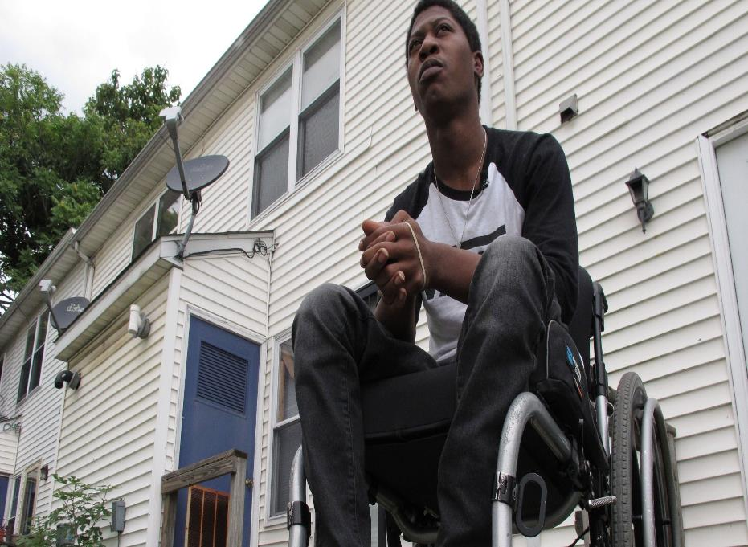
USA TODAY September 8, 2017

Slide 60
“They made the ultimate sacrifice. It will not be in vain.”-D. Chambers

Slide 61
The resources are there, is the will?

Slide 63
Transformational Education
DIALOGUE
ACTION
REFLECTION

Slide 64
Traditional Academic Researcher Outcomes
Program Evaluation
Can the student call 9-1-1?
Can students find the pulse?
Do they know how to put on a tourniquet?
Can they apply pressure?
Can they pack a wound?
Outcomes
Does it save a life?
Have we reduced blood transfusion?
How many students can we train?
Does it aid first responders?

Slide 65
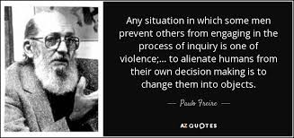
Pedagogy of the Oppressed

Slide 66
Community Engaged Research
DIALOGUE
ACTION
REFLECTION

Slide 67
Pedagogy of the Oppressed

Slide 68
Pedagogy of Freedom

Slide 69
PAR Researcher to Lead
11 Street identified
Credible messengers
Trained in research methodology
Affiliated with University of Delaware
Affiliated with City organizations and government

Slide 70
PAR TEAM

Slide 71
Build it and they will come…as long as PAR APPROVED

Slide 72
Become an Instructor

Slide 73
Wilmington Under Pressure

Slide 74
Providing the Space for Dialogue
BARBERSHOPS
CHRISTINA CULTURAL ARTS CENTER
WILMINGTON HOSPITAL CAMP FRESH
Youth Empowerment Project
HOPE Commission

Slide 75
Community Engaged Research
DIALOGUE
ACTION
REFLECTION

Slide 76
4L. M,KKGHUJM
THANK YOU!!

Slide 77
Participatory Action Research (PAR)
Notes:
DISCUSSION ORIGIN
COMPLEX
HOW PAR OPERATIONALIZE
Connective tissue

Slide 78
THE COLLECTIVE WE
Notes:
REVOLUTIONARY-social info hub
GIVEN PEOPLE A VOICE
PAT RILEY
BUILDING HOPE

Slide 79
ACCESS GRANTED
Notes:
SOCIAL CAPITAL-ADDRESSING STRUCTURAL VIOLENCE
CCHS
YRS
ACADEMIA
A.C.L.U.
DOC
COPORATE/CIVIC BOARDS
SEATS OF POWER

Slide 80
THE PAR FAMILY
Notes:
EXPANDING
EMBEDDED-comm. days (sponsor, service oriented
PRODUCING-leaders

Slide 81
HEALTHY COMMUNITIES
Notes:
CCHS-WILMINGTON UNDER PRESSURE/VIOLENCE REVIEW
CEASE VIOLENCE WILMINGTON
Wilmington Under Pressure
PRODUCE CHANGE/USELESS
Action oriented

